Slide 1



Isotope Production Activities at LANSCE-IPF: Development of a new Nb(p,x)⁹⁰Mo Monitor Reaction and La(p,x) Cross-Section Measurements
Andrew S. Voyles
05 November 2018 – 2018 LANSCE User Group Meeting
Notes:
Emerging trends for next-generation (targeted & personalized) nuclear medicine:
Targeted alpha therapy (5-10 MeV)
40-80 μm range → single cell
Targeted Auger therapy (20 eV – 1 keV)
1 nm – 2 μm → cellular nucleus
Theranostic medicine
Simultaneous imaging and therapy

Slide 2
Development of a new Nb(p,x)⁹⁰Mo Monitor Reaction
___________________________
^{Intermediate Energy – LANL}

Slide 3
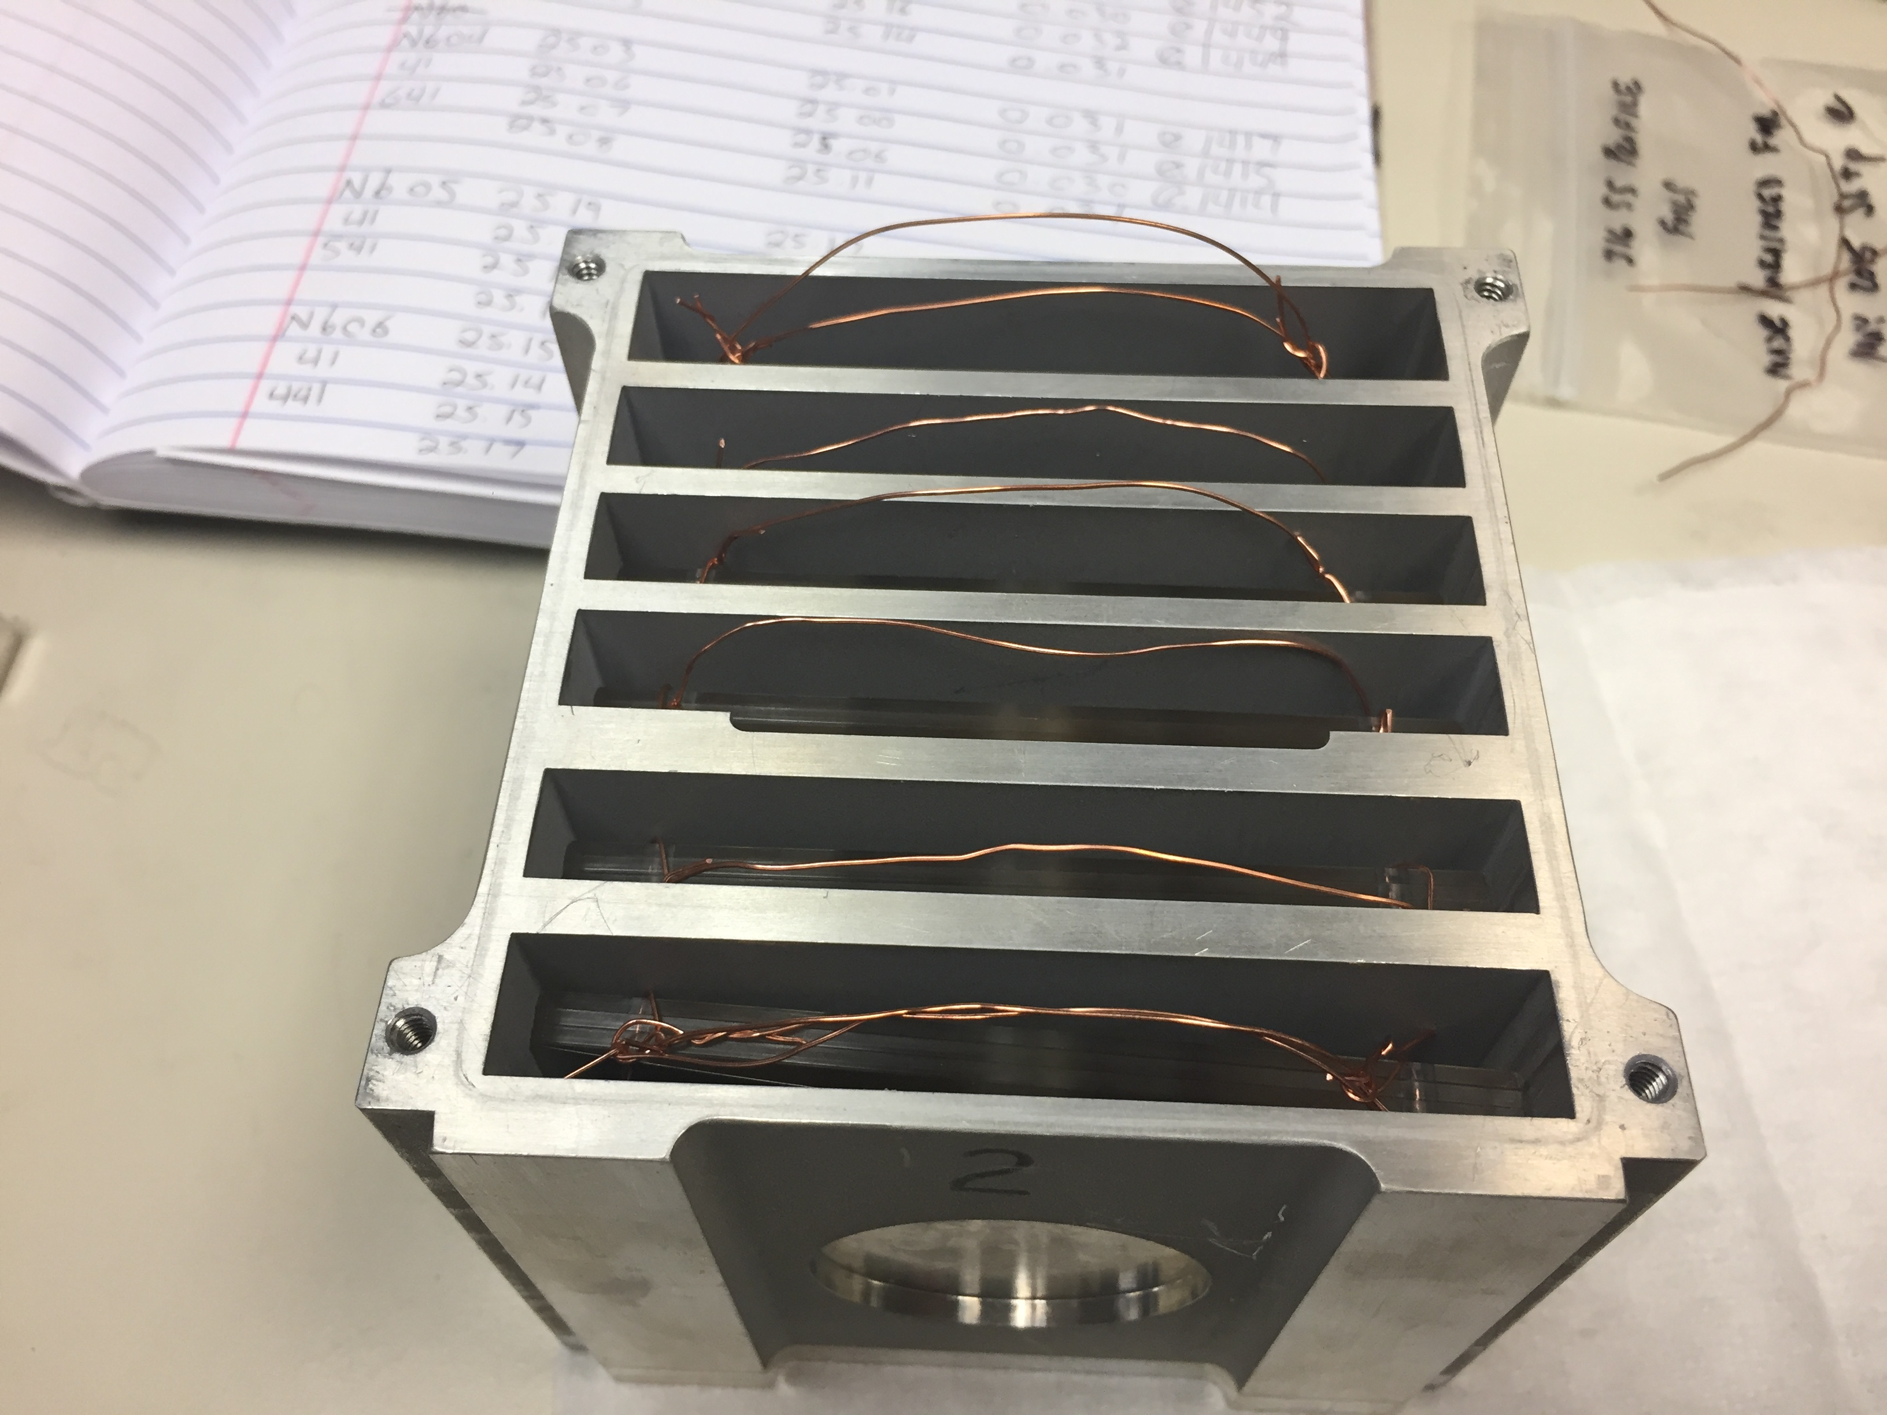
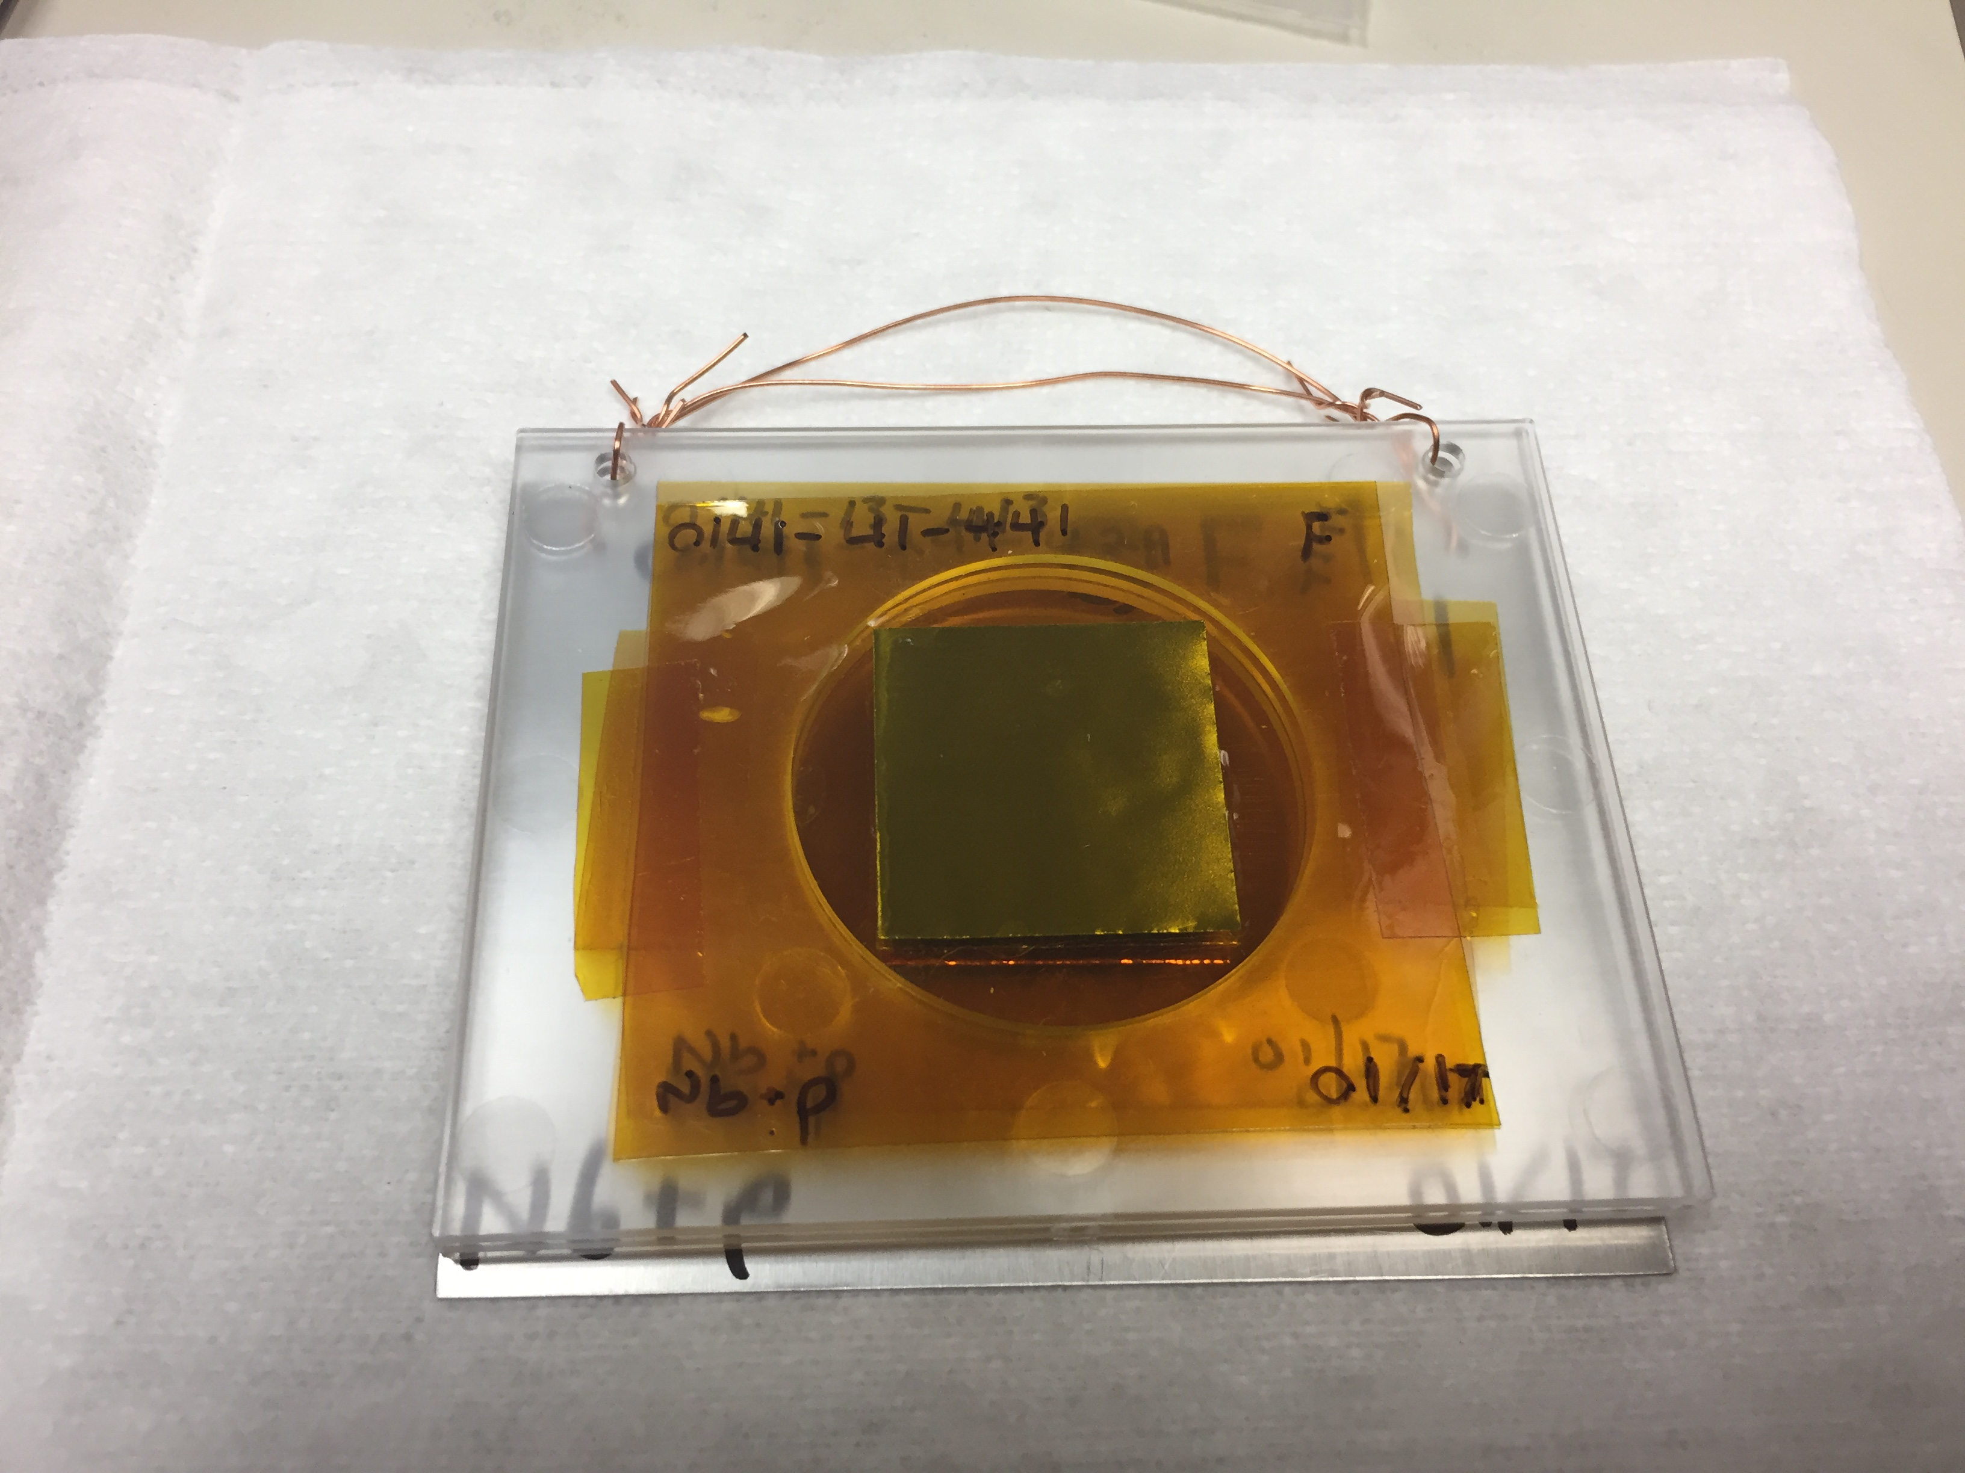
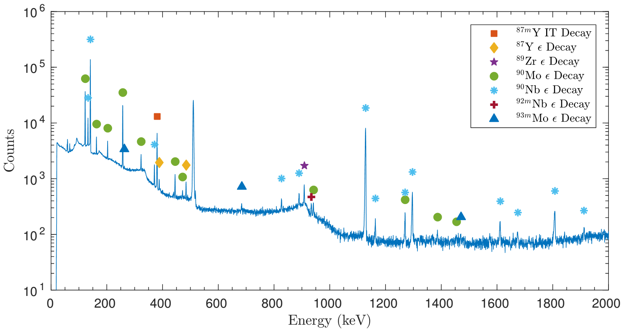
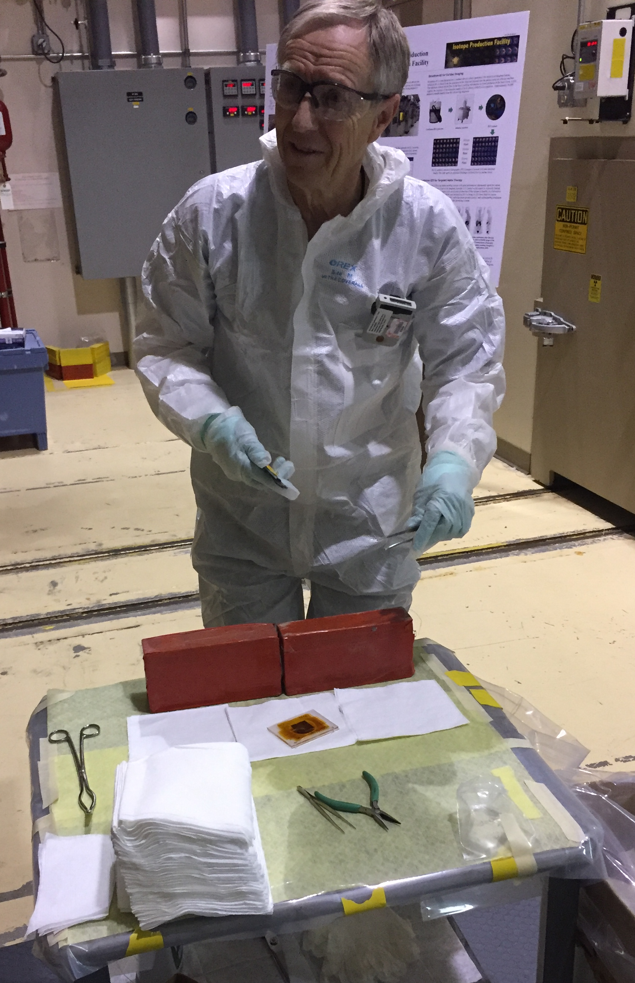
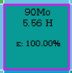
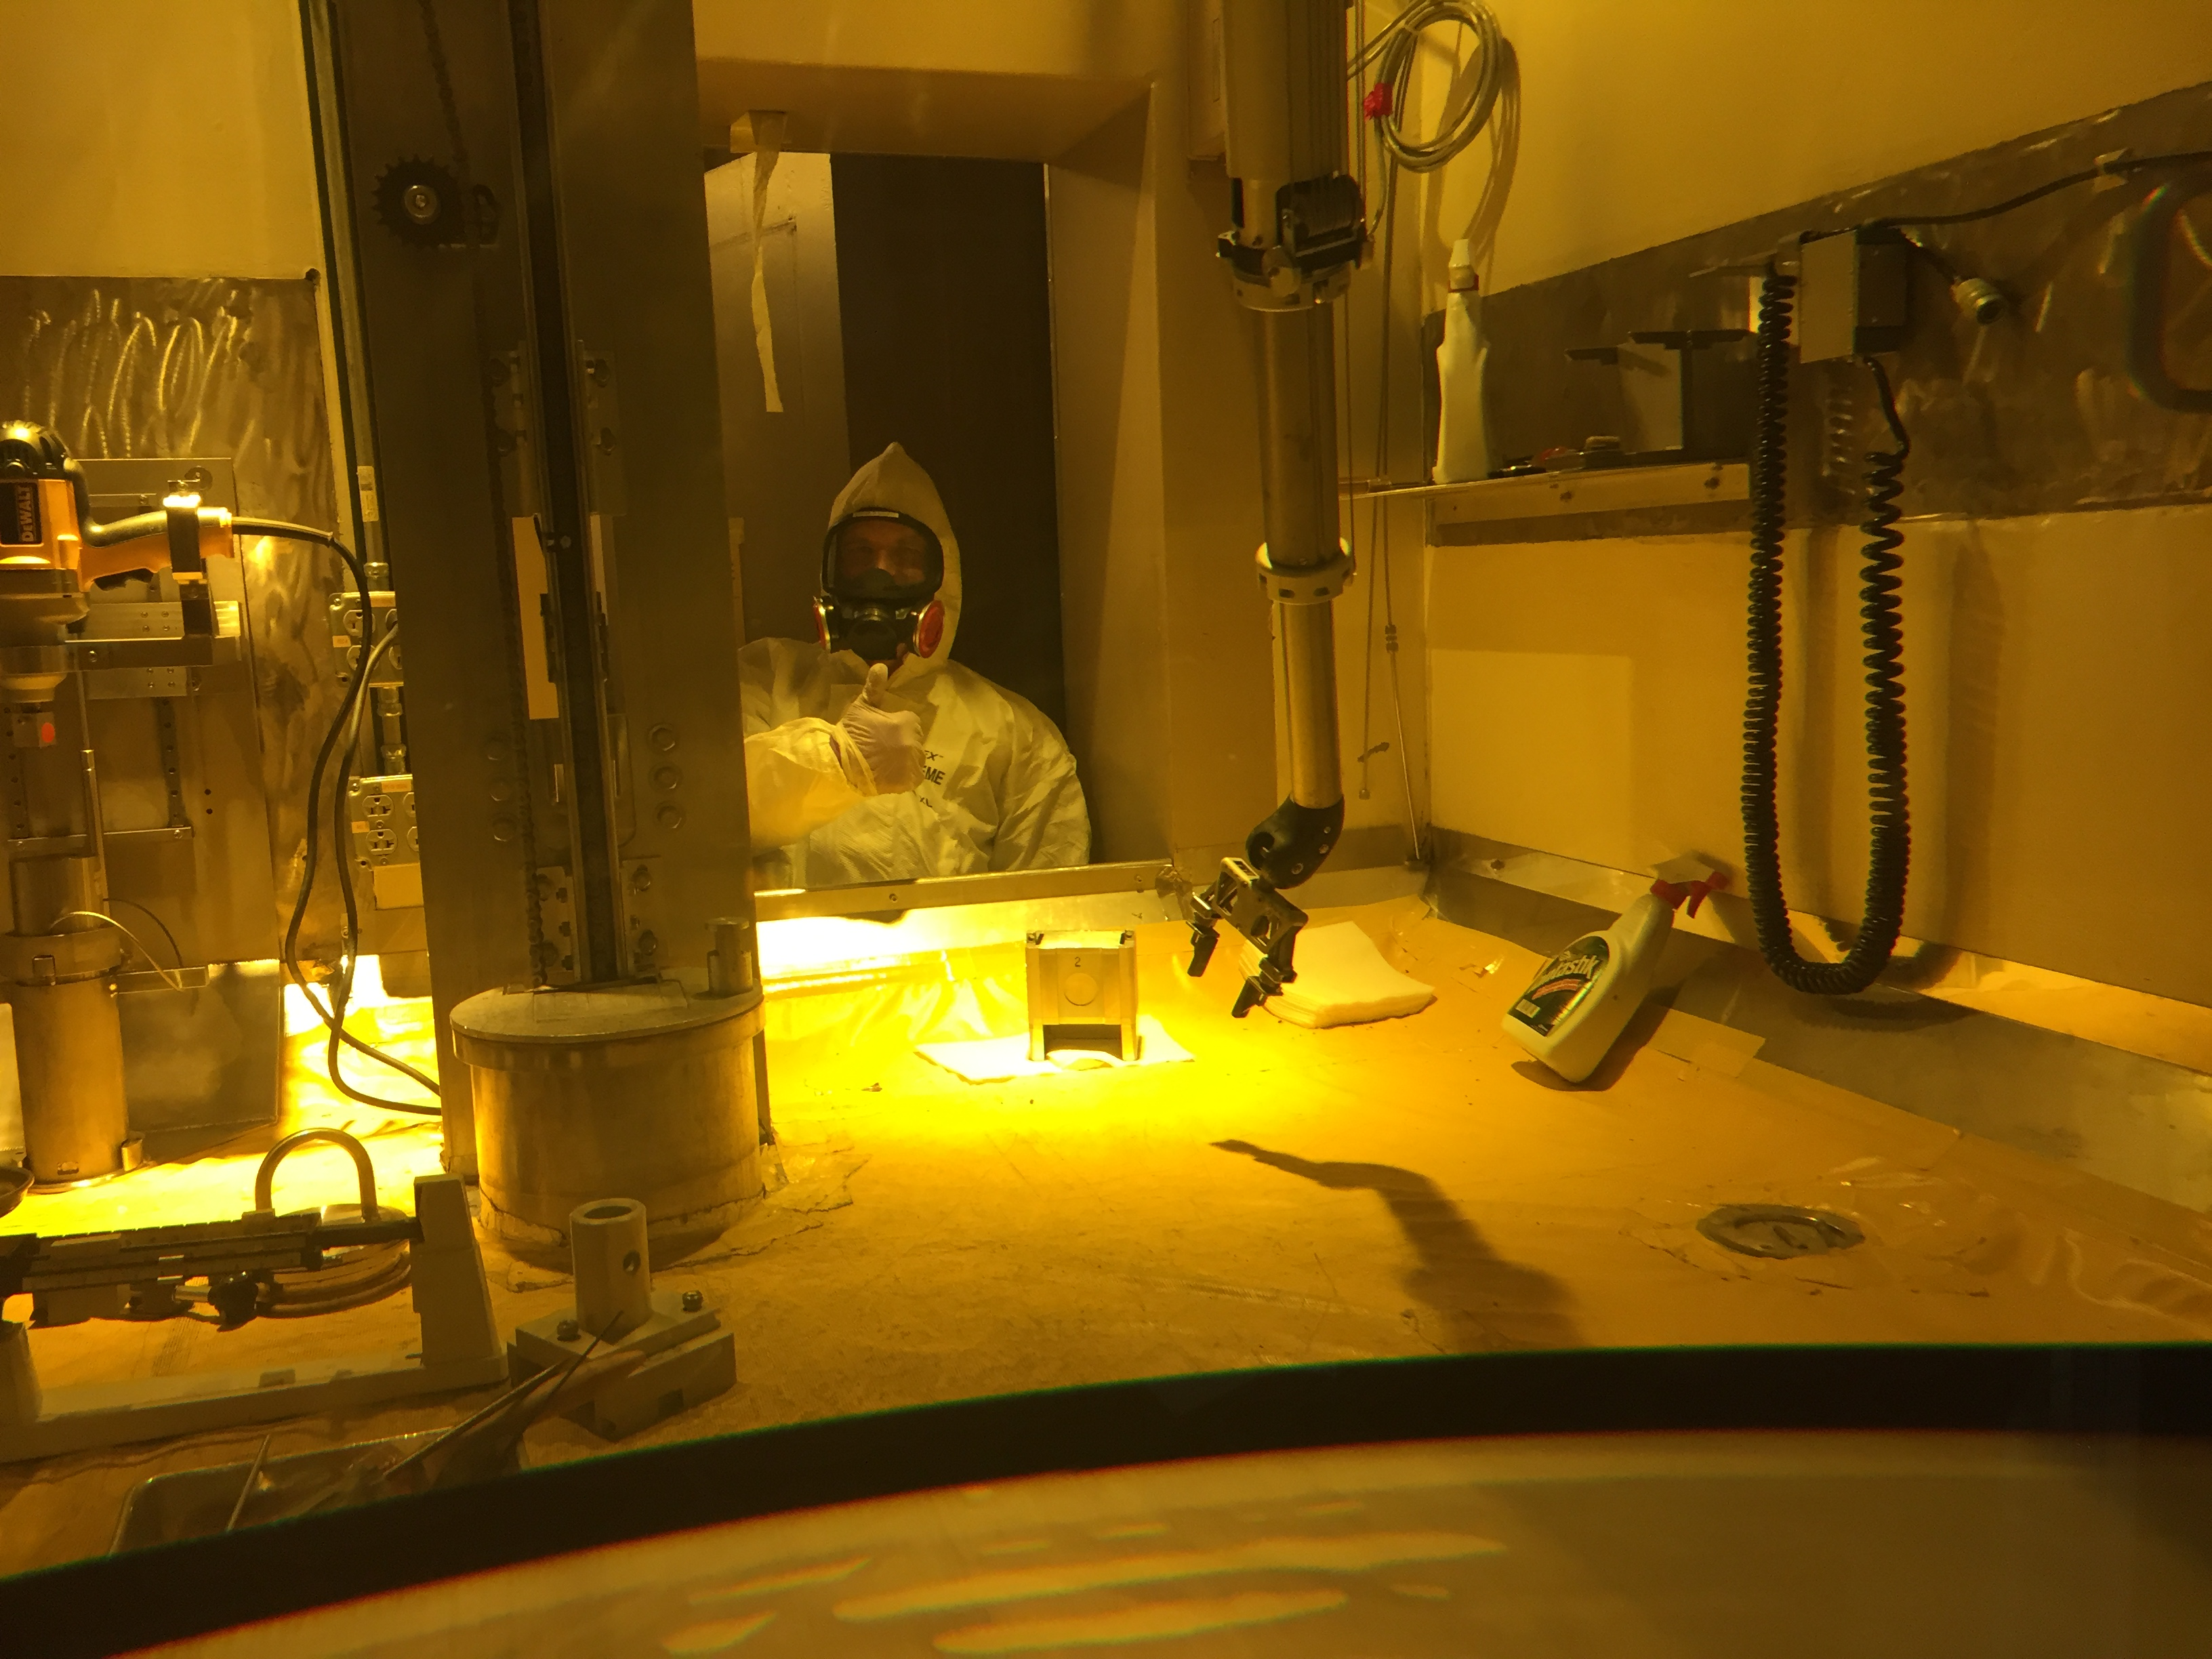
Measurements @ LANL – Nb(p,x)
Well-characterized monitor reaction data is a top-priority objective
Vital for determination of fluence, energy for isotope production
Current data are deficient for E_{p}>30 MeV
A stacked target measurement was run at LANSCE-IPF to help develop the ⁹³Nb(p,4n)⁹⁰Mo reaction as a new 30-200 MeV proton standard
Proton Injectors
IPF
201.25 MHz Drift Tube Linac
p+
805 MHz Side-Coupled Cavity Linac
800
MeV
p+
p-
800 m
p-
750 keV
100 MeV
M. Nortier
[1] A.S. Voyles, NIM B 429 (2018)

Slide 4
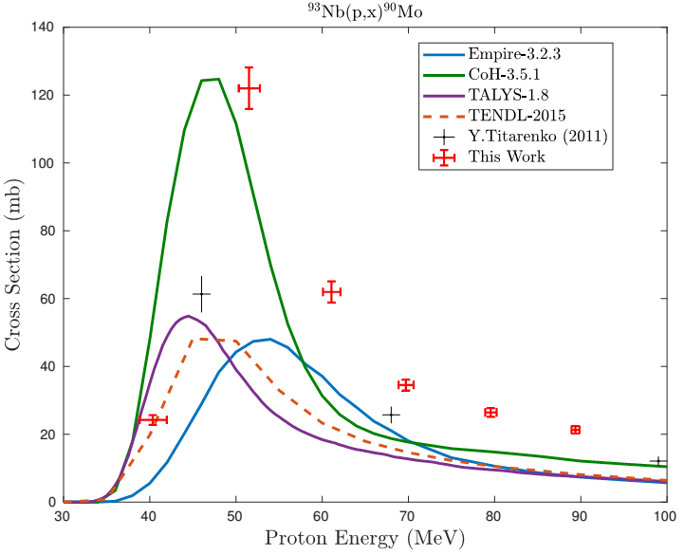
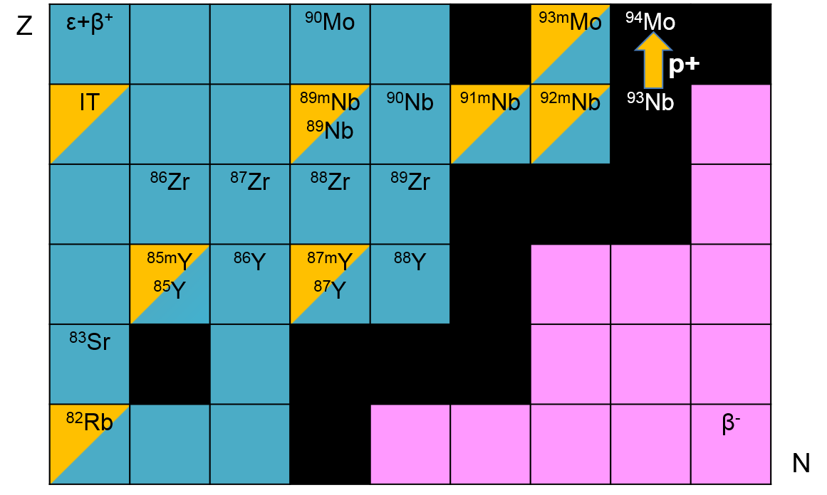
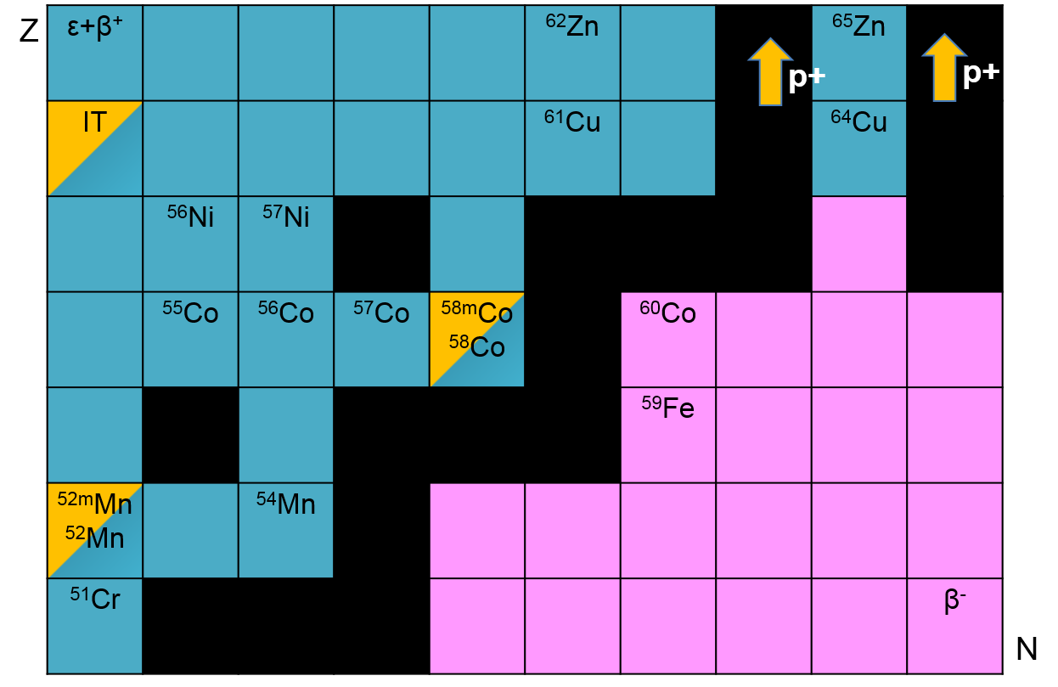
Measurements @ LANL – Nb(p,x)
Pathway for medical radionuclides: ^{82m}Rb, ⁸⁶Y, ⁸⁹Zr
Measurements of 38 cross-sections for ⁹³Nb(p,x) and ^{nat}Cu(p,x)
A.S. Voyles et al., “Excitation functions for (p,x) reactions of niobium in the energy range of E_{p} = 40–90 MeV”, NIM B 429 (2018) 53–74. June 2018

Slide 5
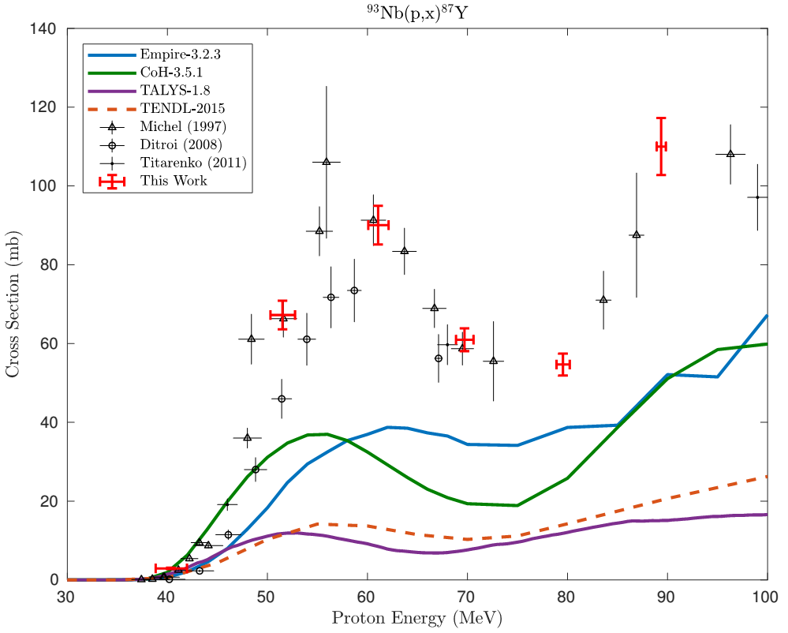
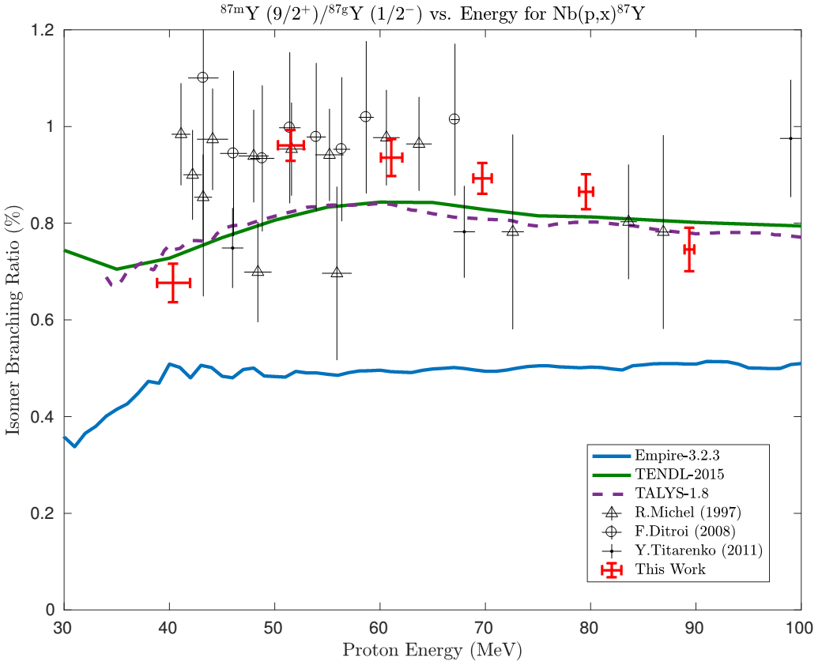
Measurements @ LANL – Nb(p,x)
5 independent measurements of isomer-to-ground state ratios
[1] A.S. Voyles, NIM B 429 (2018)

Slide 6
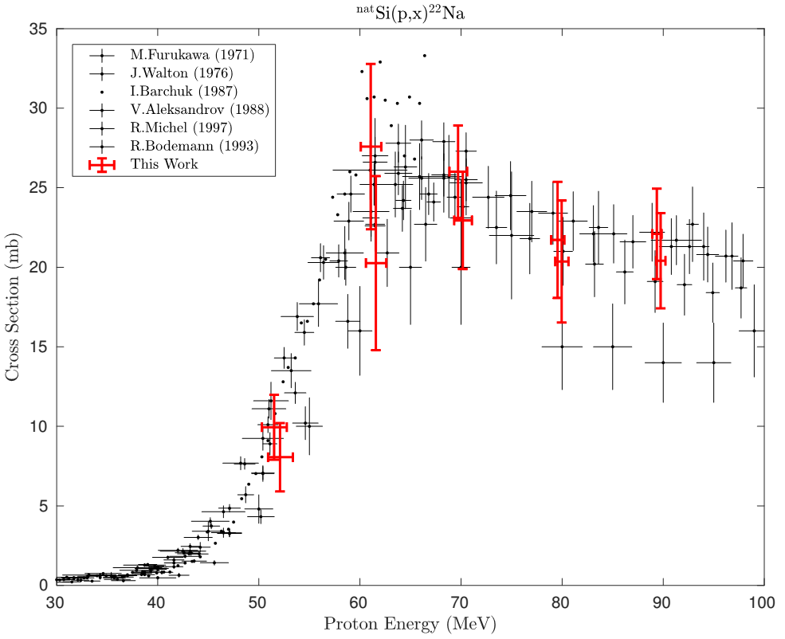
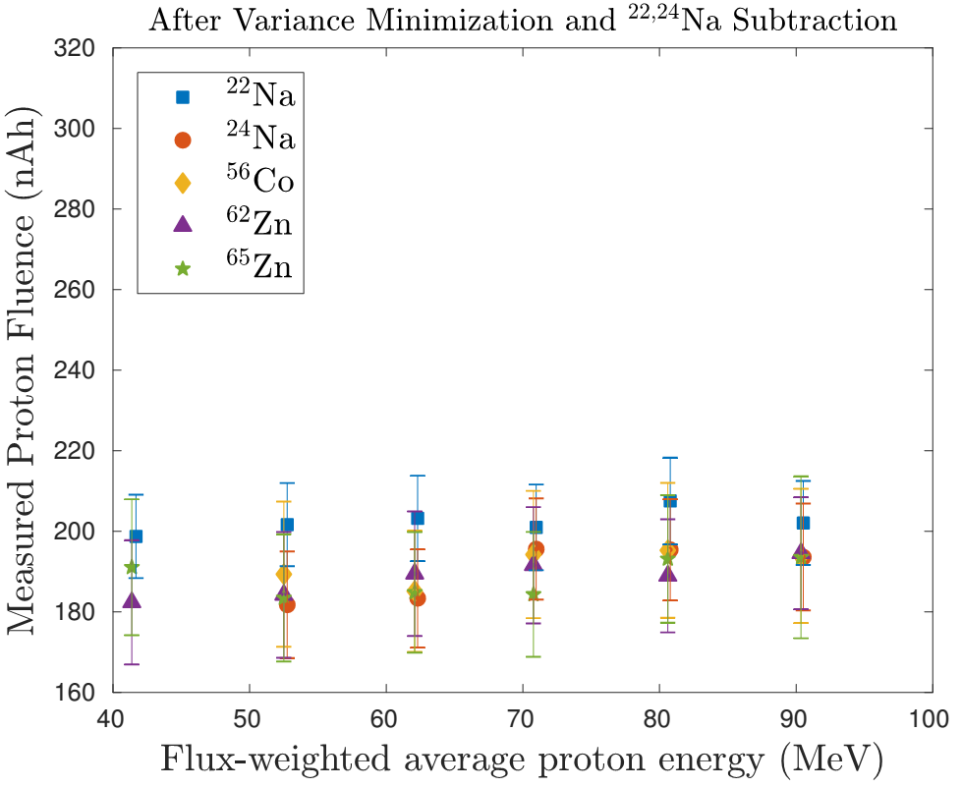
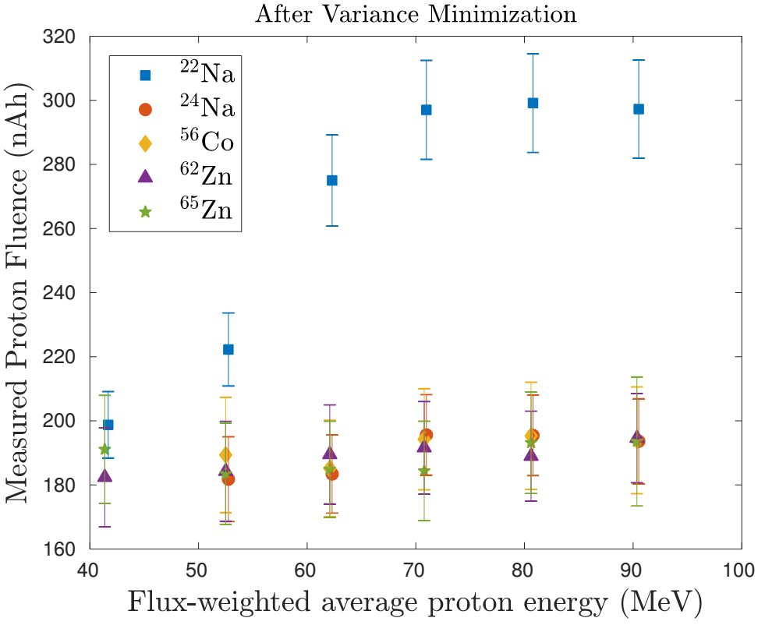
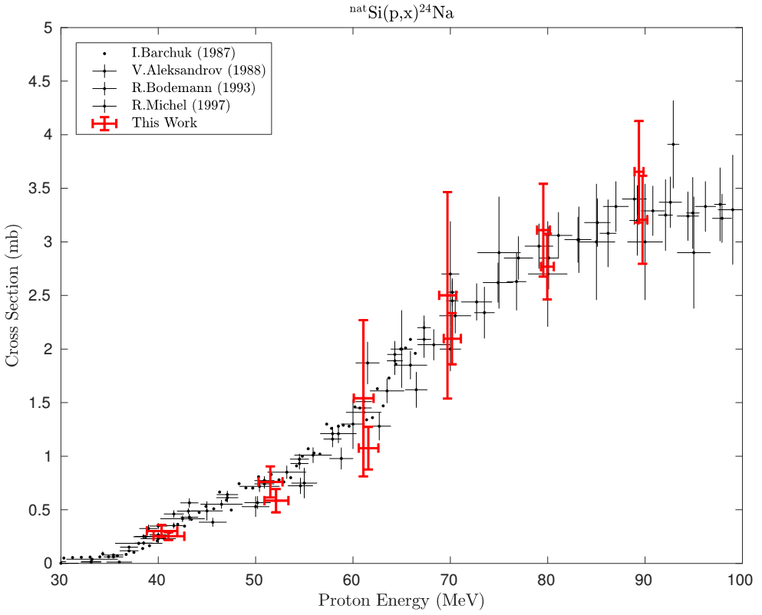
Measurements @ LANL – Nb(p,x)
“Excess” fluence seen in ^{22,24}Na consistent with production via Si(p,x)
[1] A.S. Voyles, NIM B 429 (2018)

Slide 7
La(p,x) Stacked-Target Excitation Functions
___________________________
^{Intermediate Energy – LANL}
^{Low(er) Energy – LBNL}
Notes:
Cyclotron
Many hospitals have small K~15 medical cyclotrons for PET tracer production
Leverage existing infrastructure
Explore higher energies for regional research cyclotrons, basic science
Linac
Commonly used for high-energy production (LANL – IPF)
Useful for anchoring to complementary low-energy measurements

Slide 8
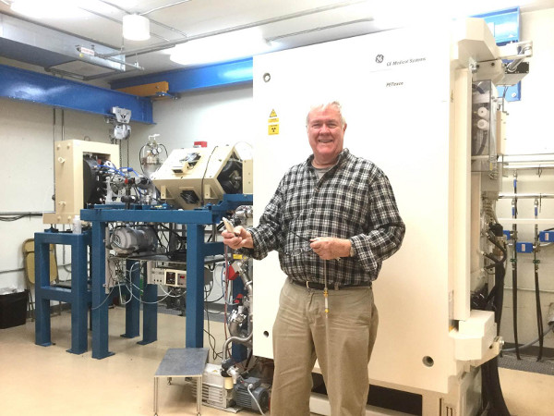
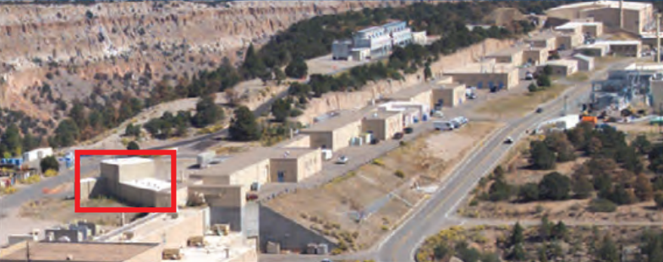
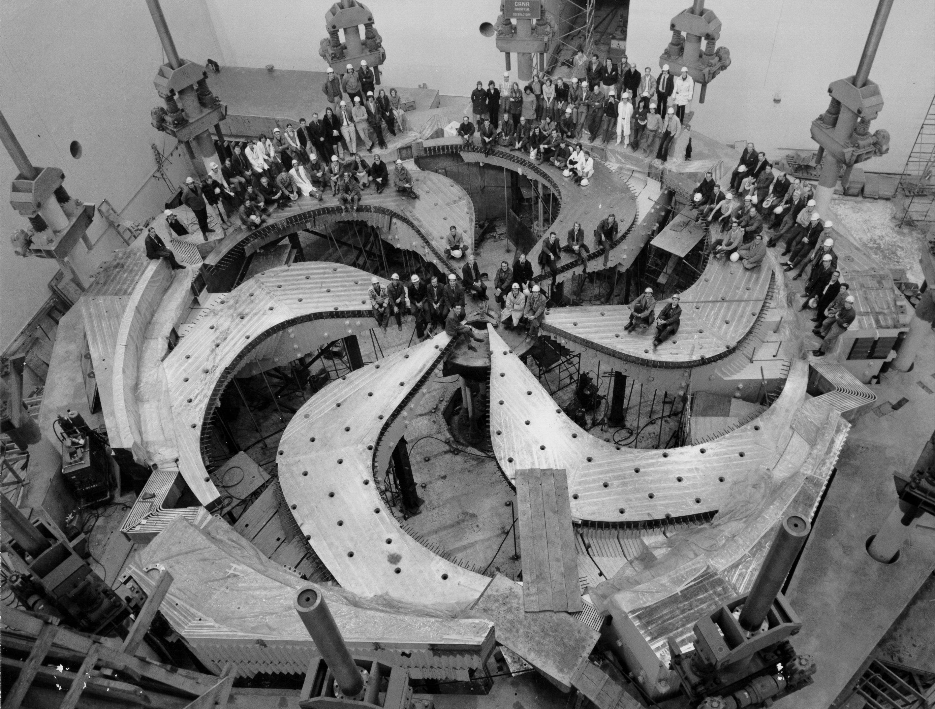
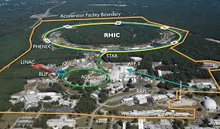
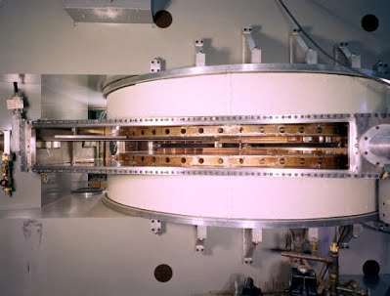
LANSCE-IPF: A Valuable “Link” in the Accelerator Ecosystem
University & Medical Cyclotrons
TRIUMF
LANSCE-IPF
18
35
50 MeV
100 MeV
200 MeV
LBNL 88-Inch Cyclotron
BLIP

Slide 9
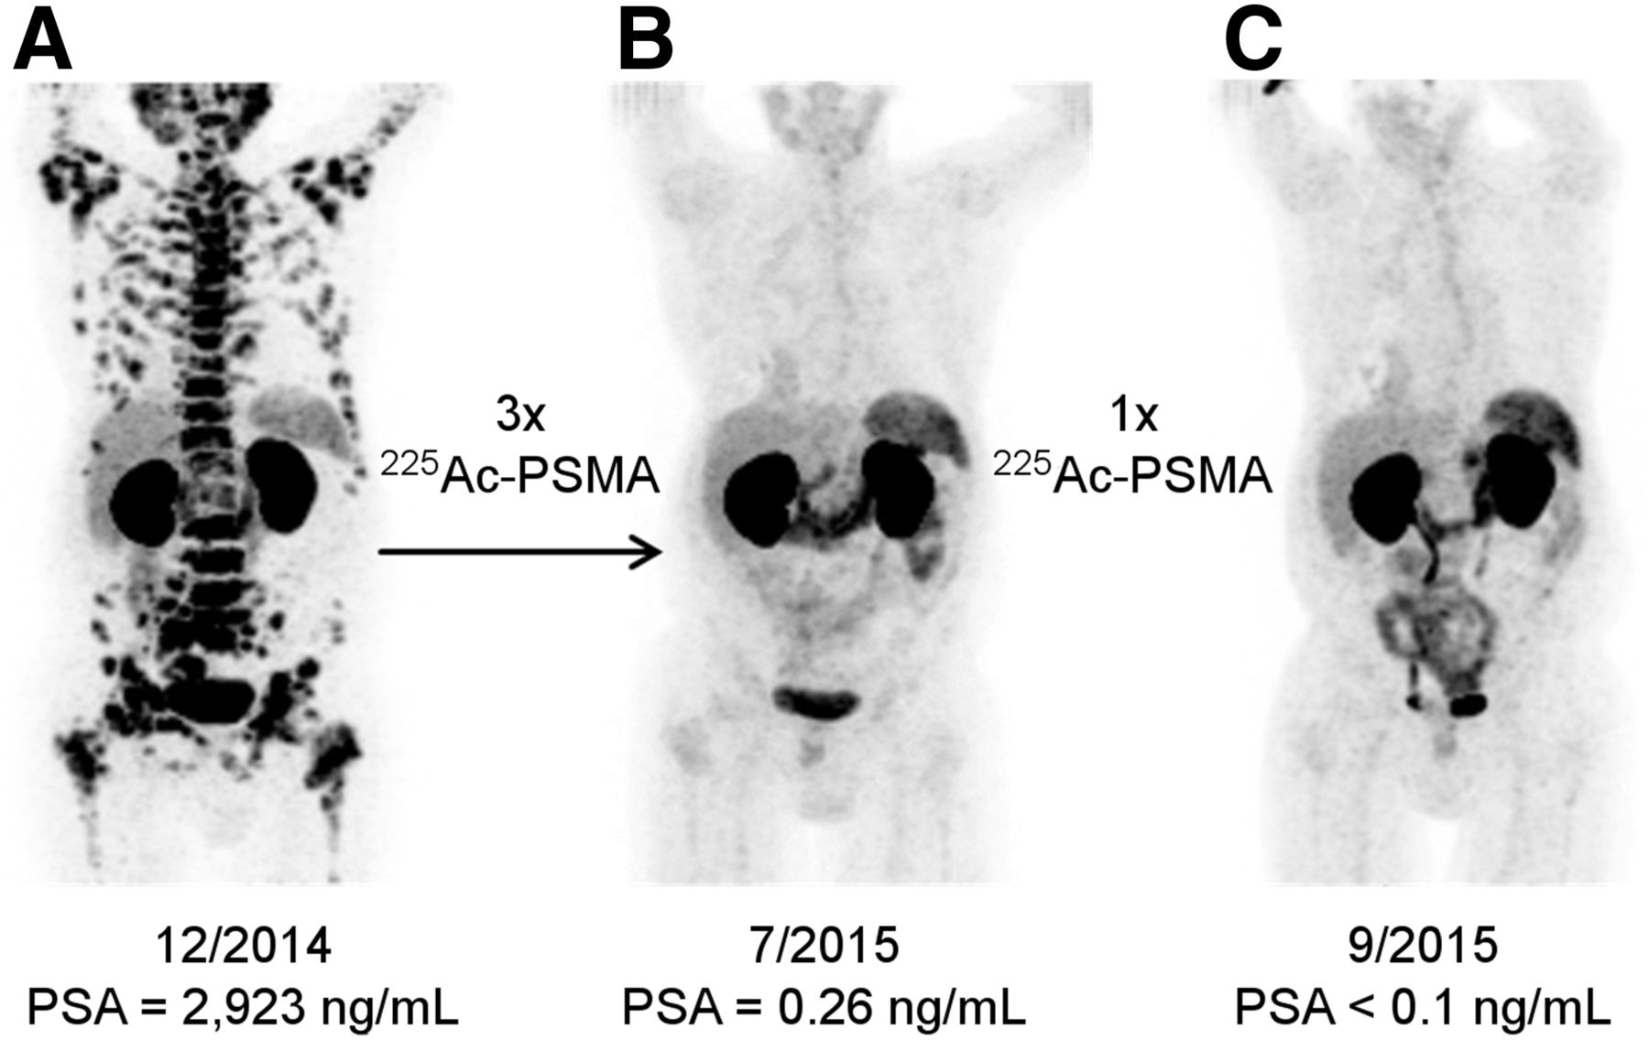

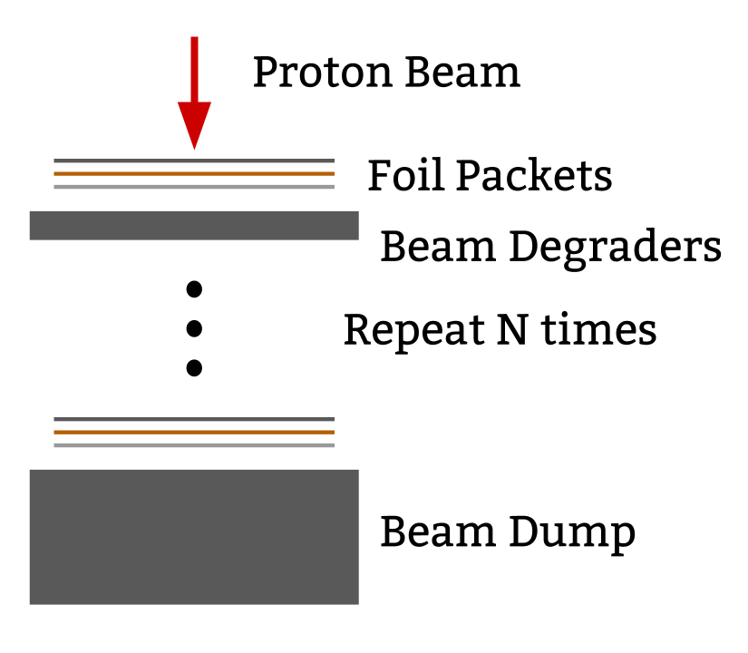
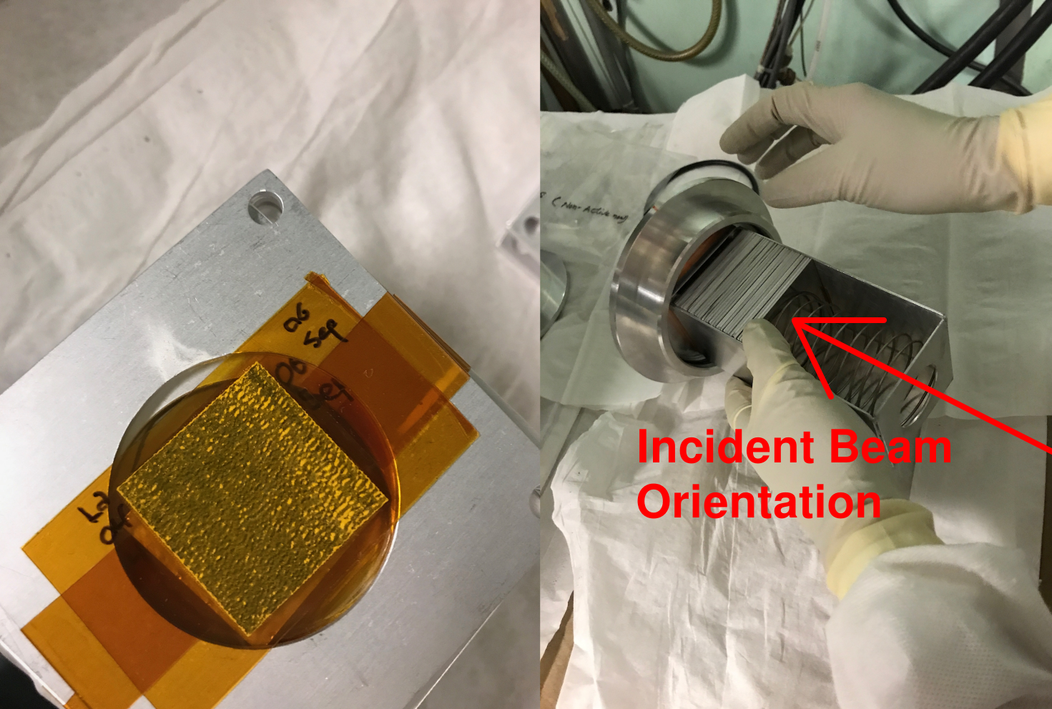
¹⁴⁰La(p,6n)¹³⁴Ce - a PET analogue for ²²⁵Ac
²²⁵Ac decay chain lacks sufficient positrons to produce a signal that can be detected by PET.
In order to employ PET to explore new uses of alpha emitters, positron-emitting, surrogate radionuclides will have to be developed.
¹³⁴Ce/¹³⁴La: t_{1/2} = 75.9 h / 6.67 m, 2.7 MeV β⁺ (62.0%)
Cross sections un-measured and reaction modeling predictions (EMPIRE/TALYS) differ by >10x
Jon Morrell
Ac³⁺
Th⁴⁺
-e¹⁻
+e¹⁻
Ce
Ce⁴⁺
Ce³⁺
¹³⁴Ce as a ²²⁷Th mimic
¹³⁴Ce as an ²²⁵Ac mimic
[2] Kratochwil, Clemens, Journal of Nuclear Medicine 57.12 (2016).
Notes:
3x 9 MBq dose fractions
Useful for bio-kinetic studies of monoclonal antibodies (the delivery agent)
Interesting nuclear physics relevance: pre-equilibrium modelling, isomer/ground state ratios
No previous measurements, only comparison to models
Surprising results: TALYS 10x over-prediction of XS

Slide 10
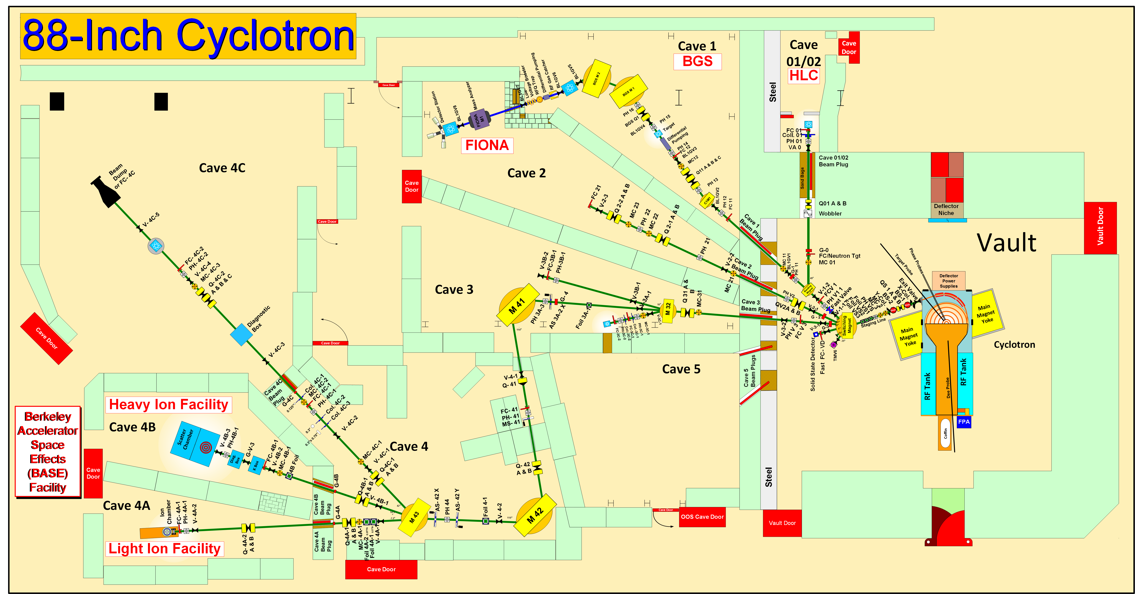
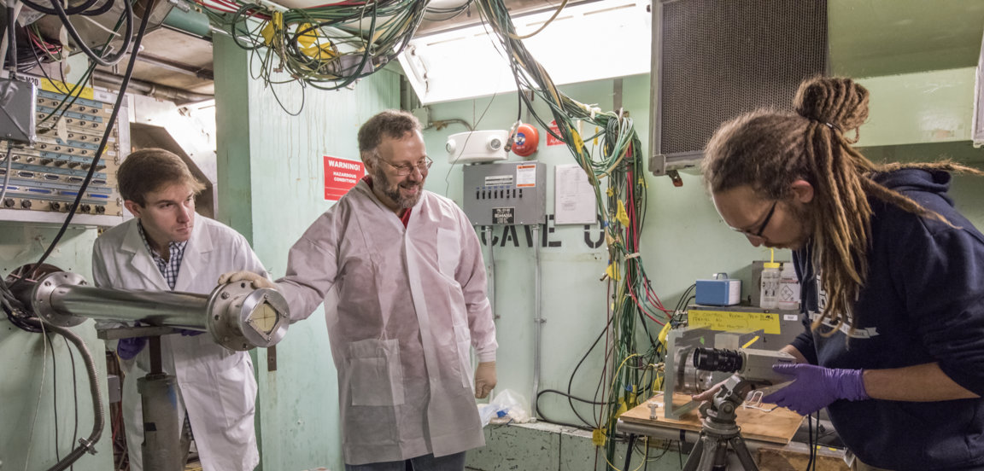
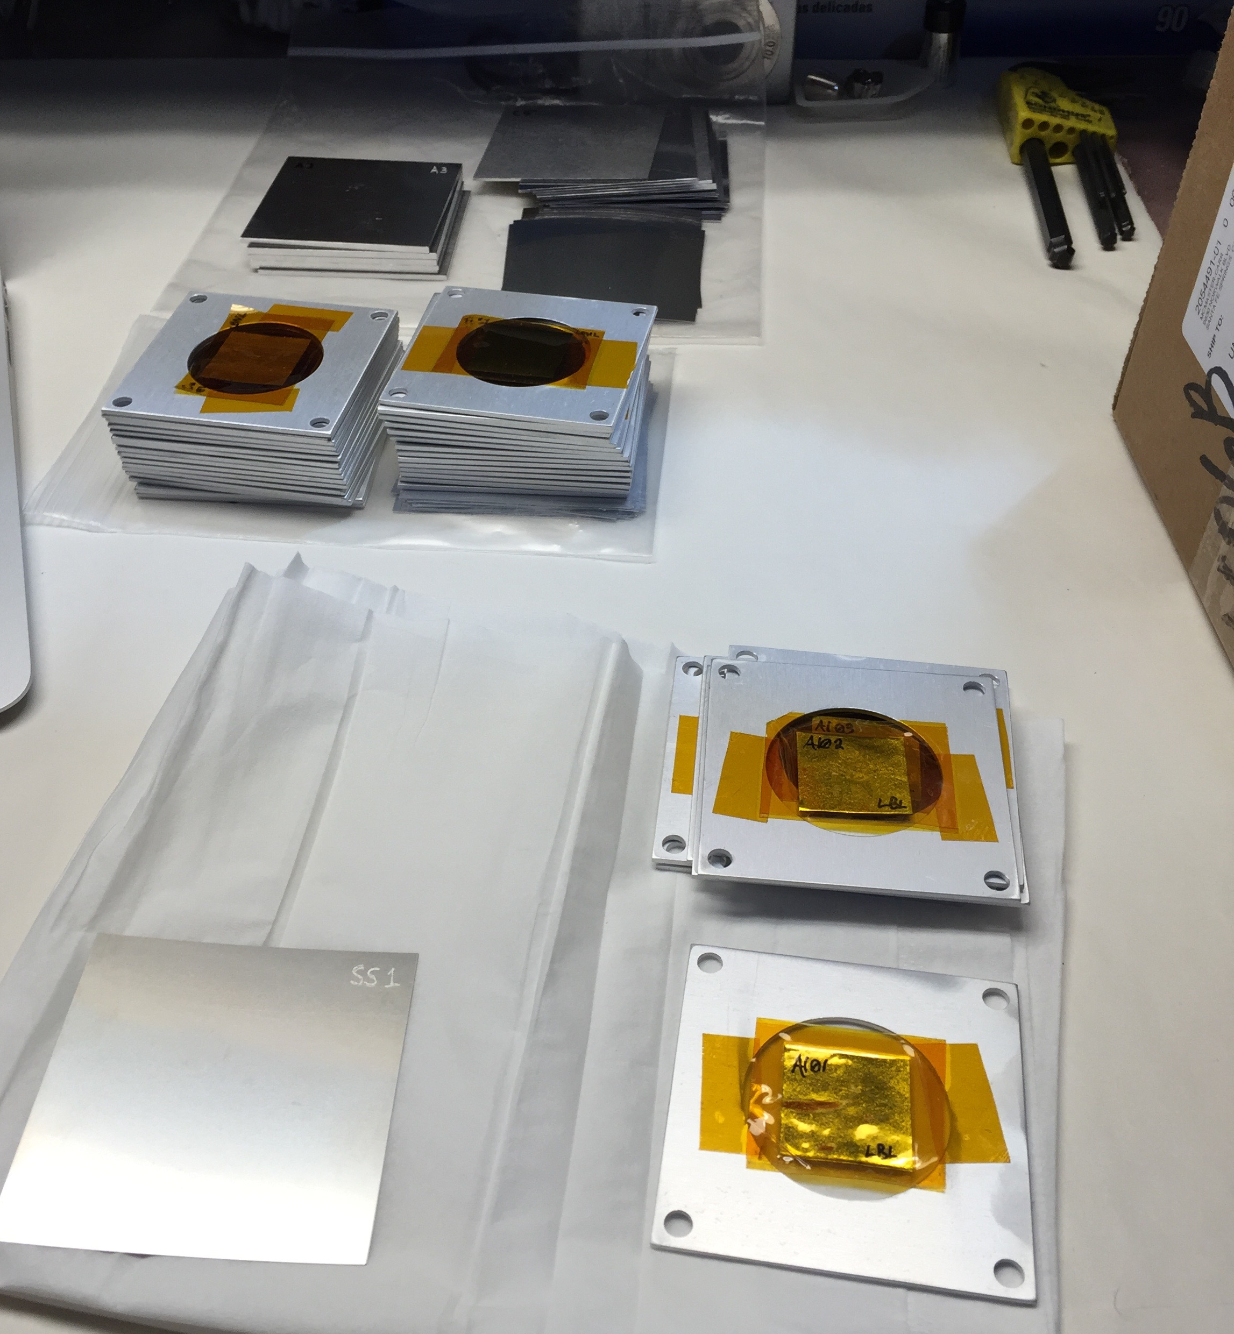
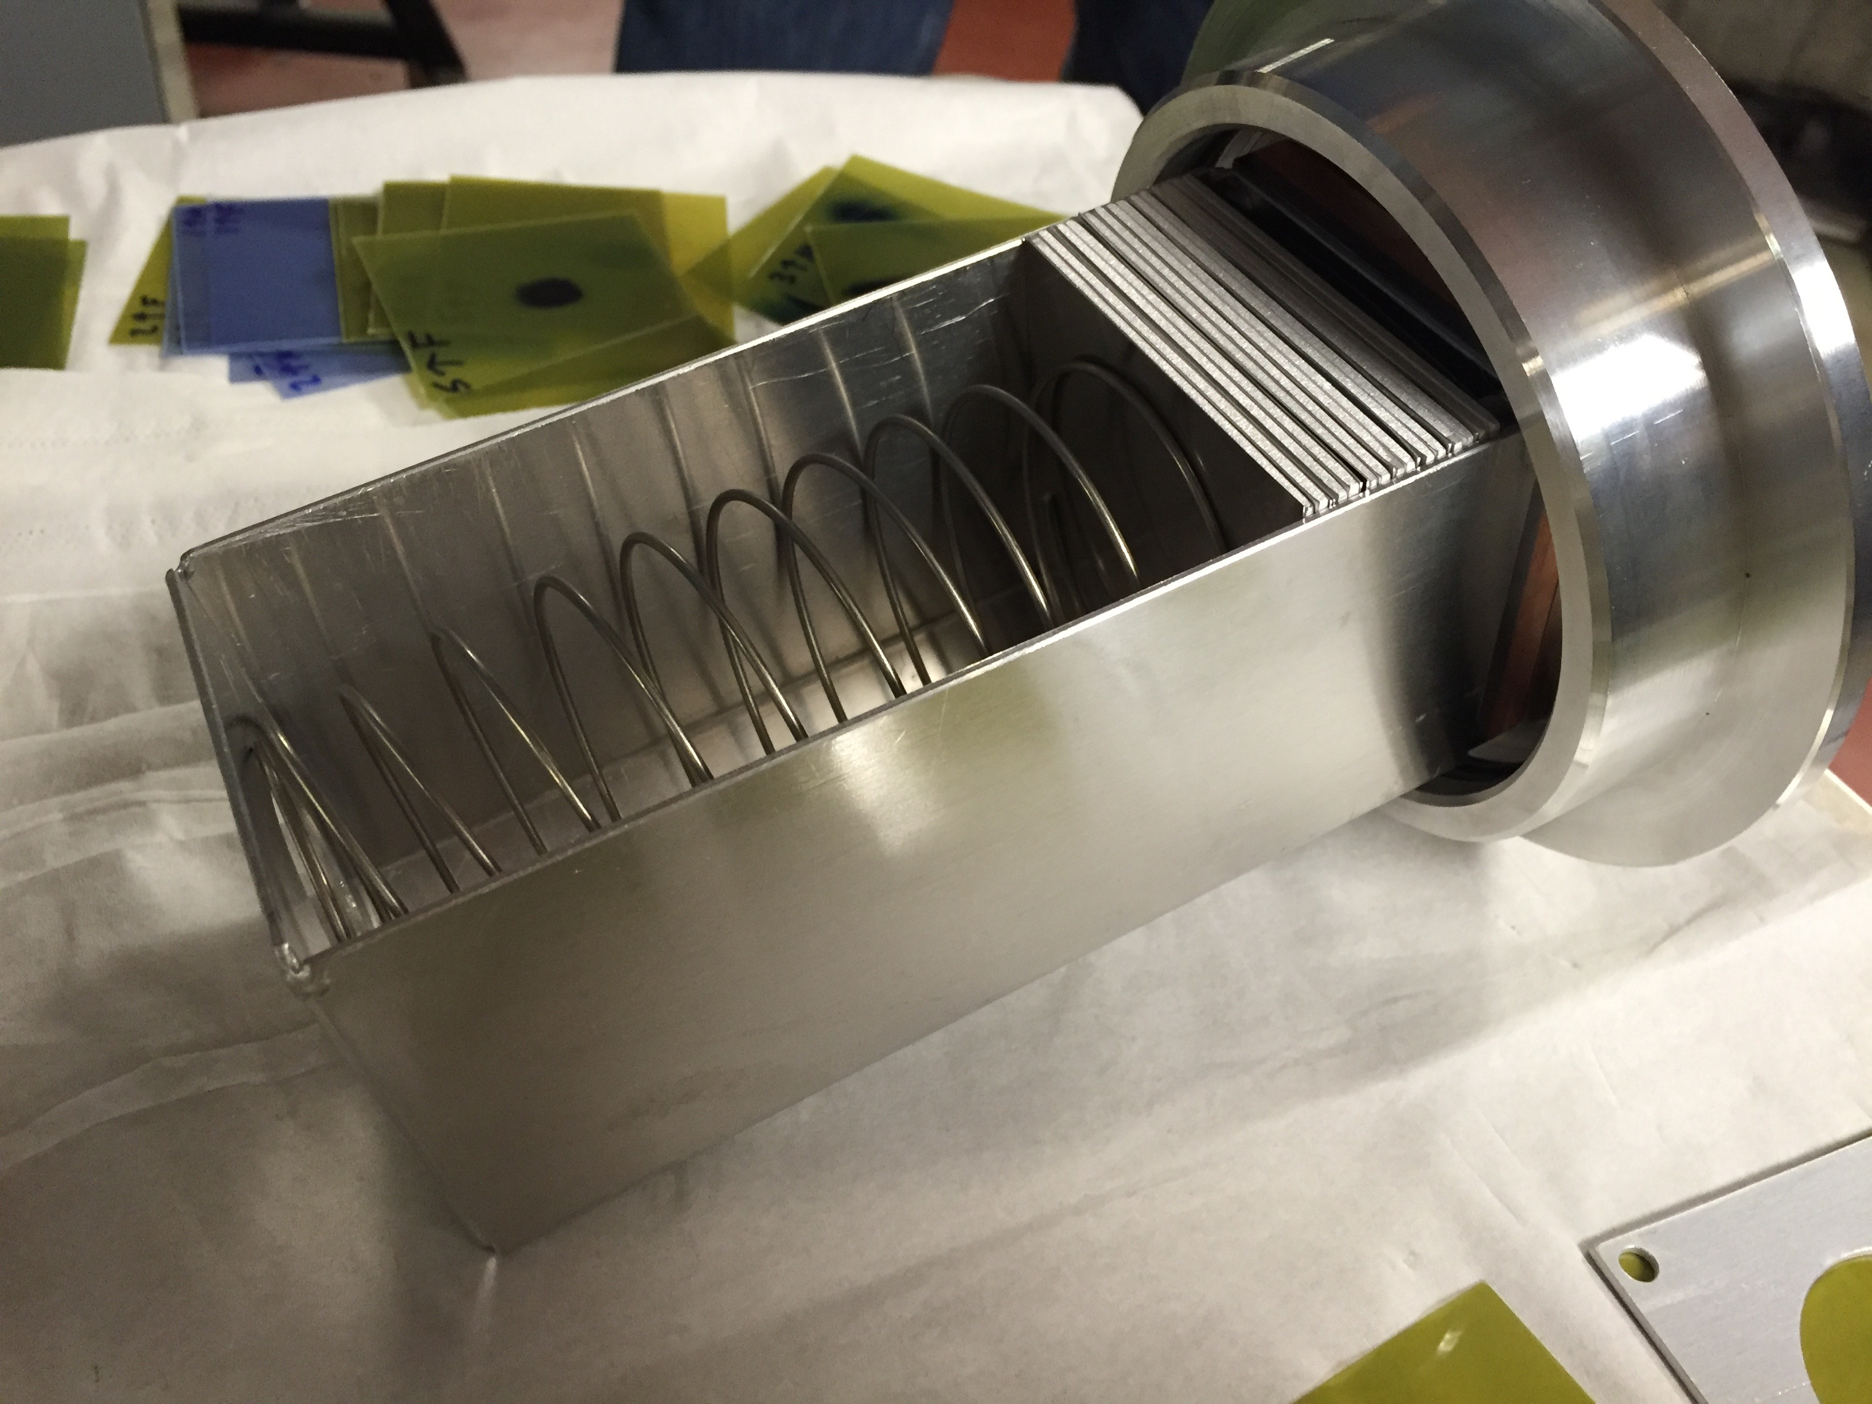
Stacked-target Charged Particle Excitation Functions
A. Springer
L. Bernstein
K-140
2016: Launched a complementary nuclear data measurement campaign at the LBNL 88-Inch cyclotron to address gaps in reaction data at E<60-110 MeV/A
Notes:
We propose to measure these reactions to resolve ambiguity in the predictions and establish optimal irradiation parameters.
Cyclotron freq w = Q B / m
T = (m/2) w^2 r^2
T/A = (B r / 2 m)^2 (Q/A)^2 = K (Q/A)^2

Slide 11
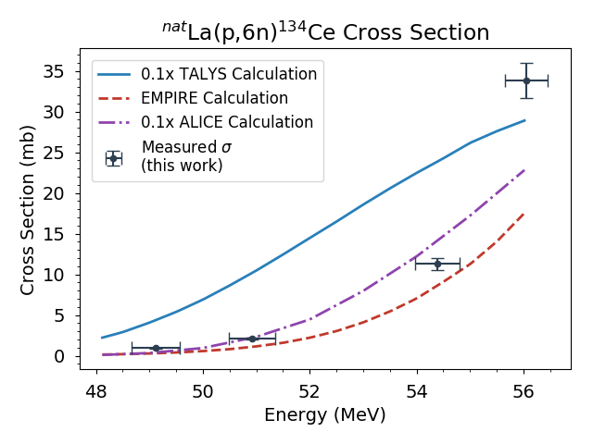
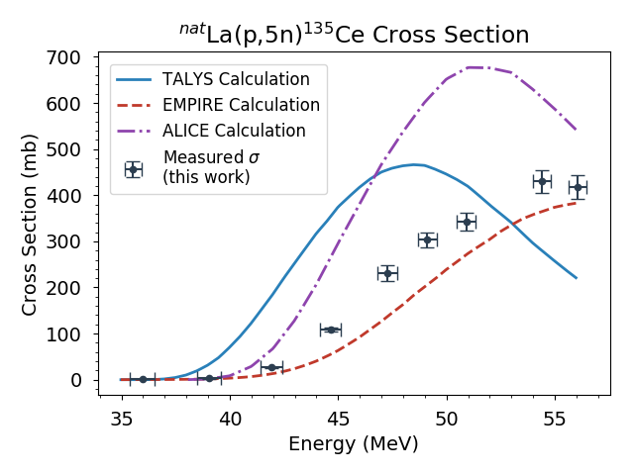
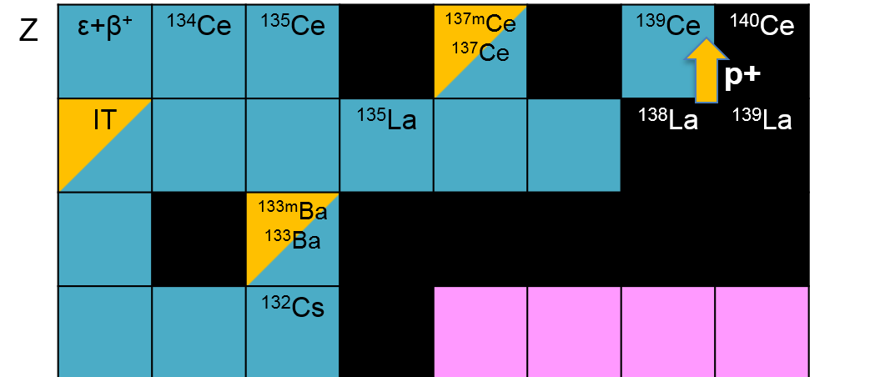
¹⁴⁰La(p,6n)¹³⁴Ce - a PET analogue for ²²⁵Ac
¹³⁵Ce is major contaminant: higher-energy ≈70 MeV beam required for clean production of ¹³⁴Ce
TALYS and ALICE overpredict (p,6n) cross section by >10x, XS peaks 8-10 MeV higher than predicted
Reaction code differences: Hybrid Monte-Carlo pre-equilibrium (EMPIRE) vs. Exciton model (TALYS, ALICE)
Notes:
3x 9 MBq dose fractions
Useful for bio-kinetic studies of monoclonal antibodies (the delivery agent)
Interesting nuclear physics relevance: pre-equilibrium modelling, isomer/ground state ratios
No previous measurements, only comparison to models
Surprising results: TALYS 10x over-prediction of XS

Slide 12
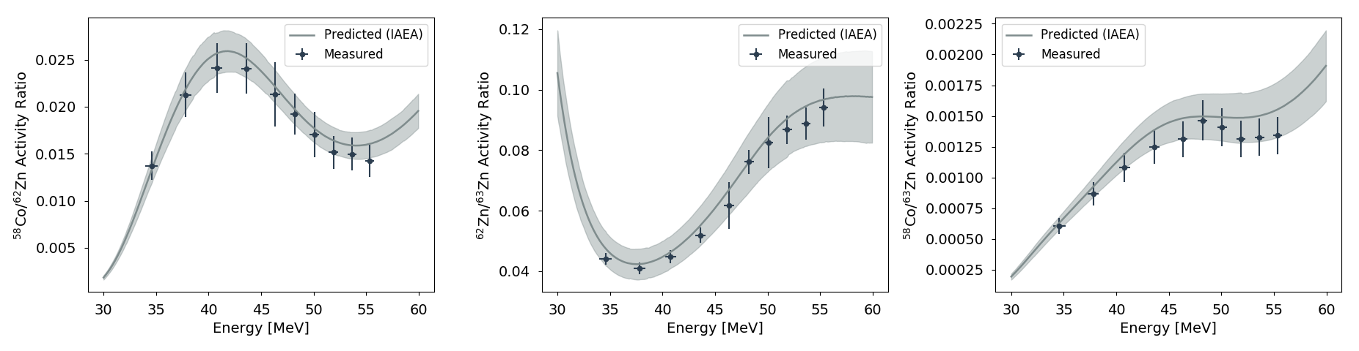
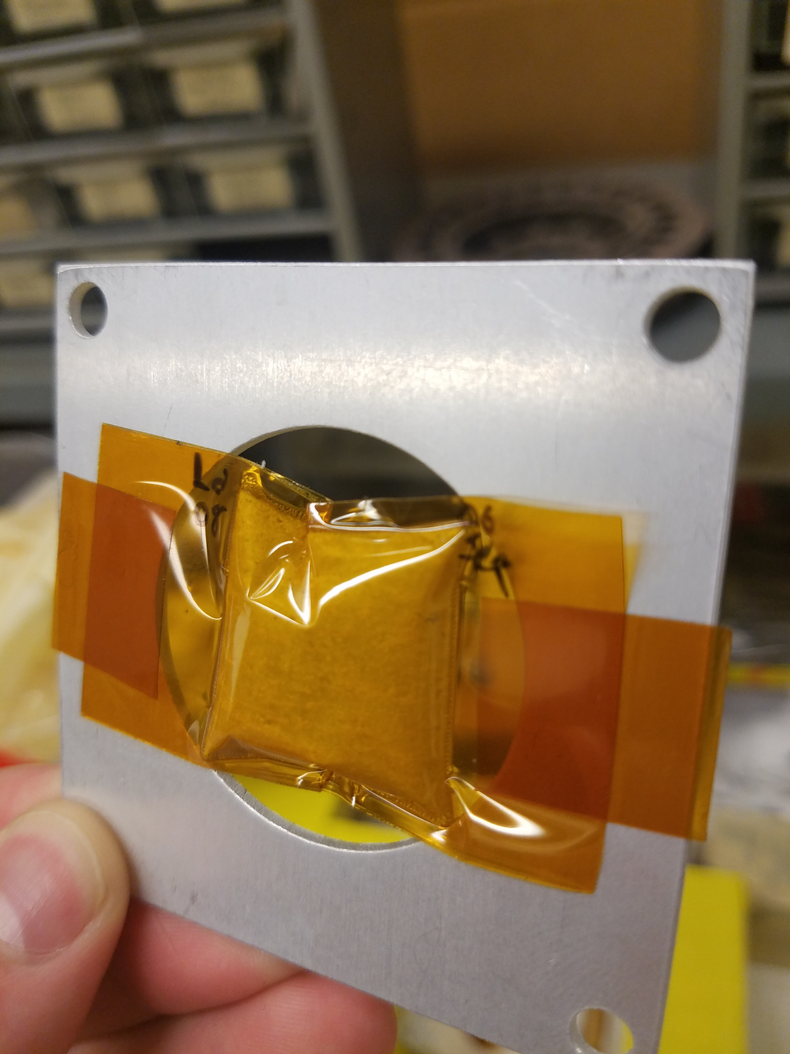
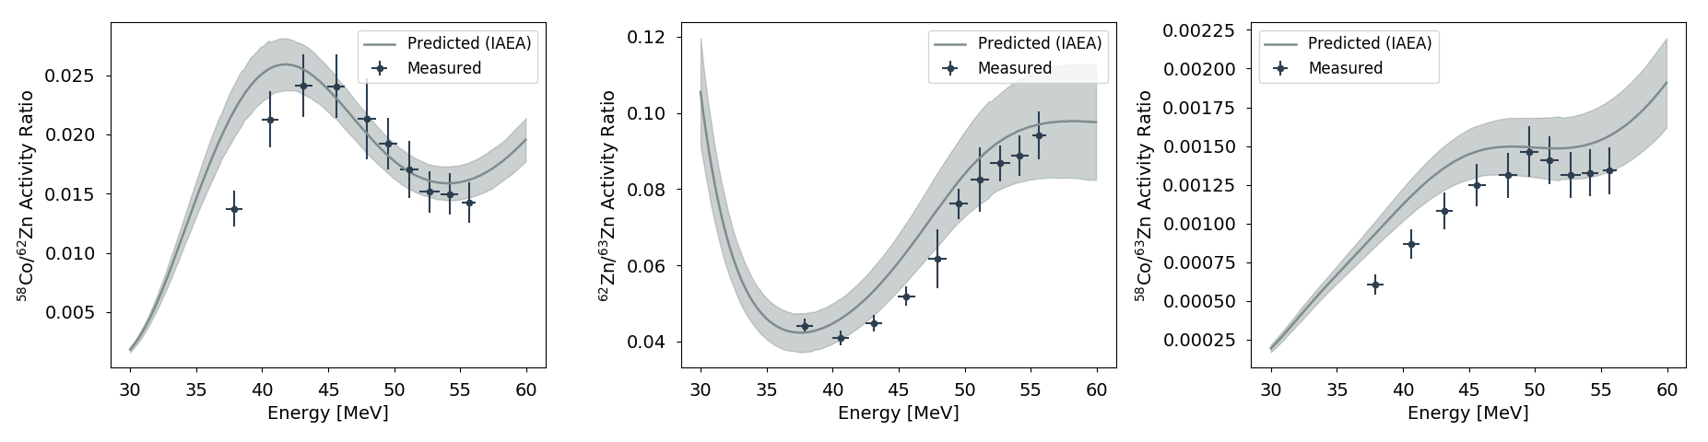
¹⁴⁰La(p,6n)¹³⁴Ce - a PET analogue for ²²⁵Ac
Anderson & Ziegler Energy Assignment
Major takeaways:
Significant deviation (>20%) between Anderson & Ziegler and MCNP6/X
Future work: explore in depth with other stacked target data
La metal targetry concerns:
Significant decomposition, outgassing post-EoB
MCNP6 Energy Assignment
Notes:
Next steps:
Extension to 100 MeV using LANSCE-IPF in October 2018
Radiochemical separation and bio-uptake studies with LBNL/LANL – TTA extraction of Ce(IV) from La(III), followed by anion exchange to remove La target material

Slide 13


Collaborators on this work
M.S. Basunia¹, L.A. Bernstein^{1,2}, E.R. Birnbaum³, J.W. Engle^{3,4}, S.A. Graves⁵, T. Kawano³, A.M. Lewis², E.F. Matthews², J.T. Morrell², F.M. Nortier³, A. Springer⁶, A.S. Voyles²
¹ Lawrence Berkeley National Laboratory
² University of California-Berkeley Dept. of Nuclear Engineering
³ Los Alamos National Laboratory
⁴ University of Wisconsin – Madison
⁵ University of Iowa – Department of Radiation Oncology
⁶ Karlsruhe Institute of Technology
We gratefully acknowledge support from:
U.S. Department of Energy, Office of Science via the Isotope Development and Production for Research and Applications subprogram in the Office of Nuclear Physics
Lawrence Berkeley National Laboratory and the U.S. Nuclear Data Program under contract # DE-AC02-05CH11231
U.S. Nuclear Regulatory Commission

Slide 14

Questions?

Slide 15
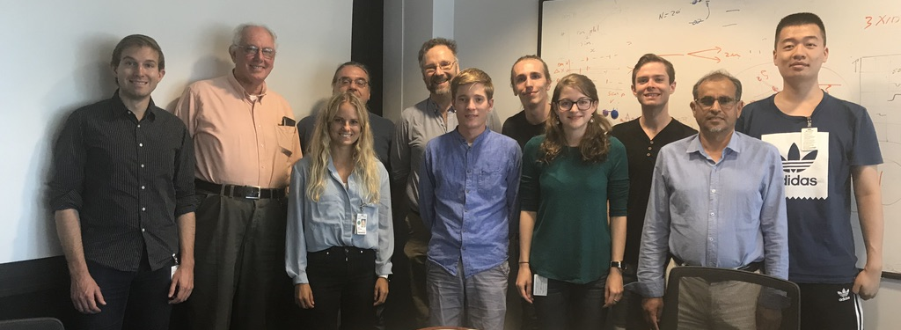
The LBNL/UCB Bay Area Nuclear Data (BAND) Group
L. Bernstein
R. Firestone
J. Batchelder
J. Morrell
I. Kolaja
A. Voyles
K. Song
M. Basunia
N. Petterson
E. Matthews
A. Lewis
Our goal is to address the data needs of the applied nuclear science community while training the next generation of nuclear scientists and engineers in the process
Camera Shy: E. Browne, A. Hurst
UCB Nuclear Engineering students lead our experimental program!
Notes:
We do this by bringing together young…and other…scientists and engineers

Slide 16
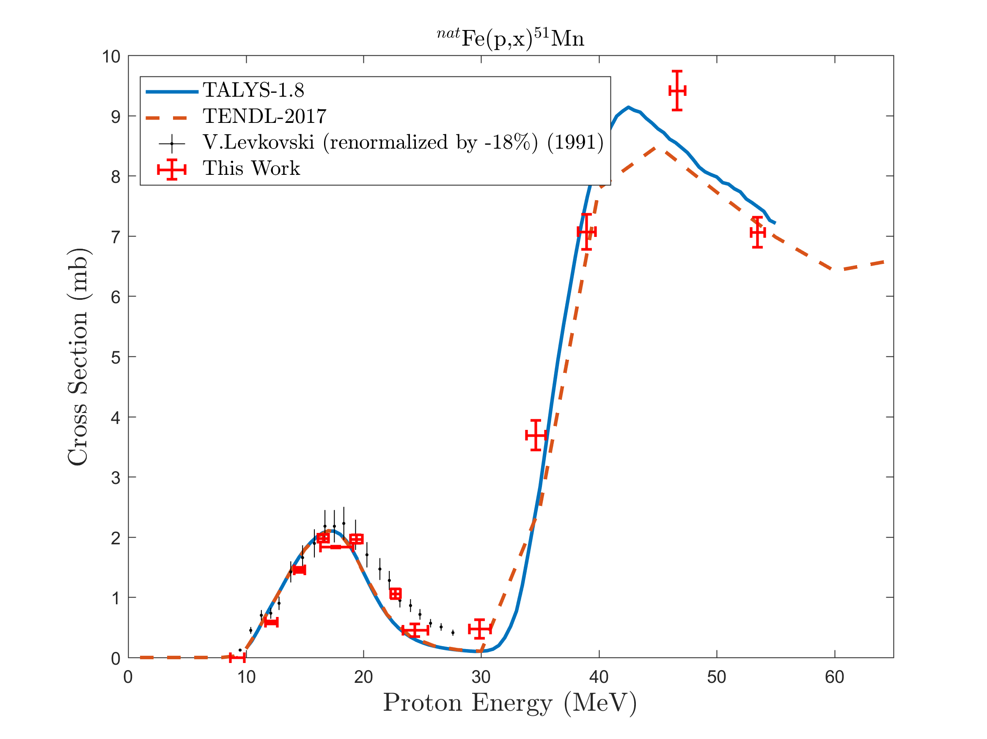
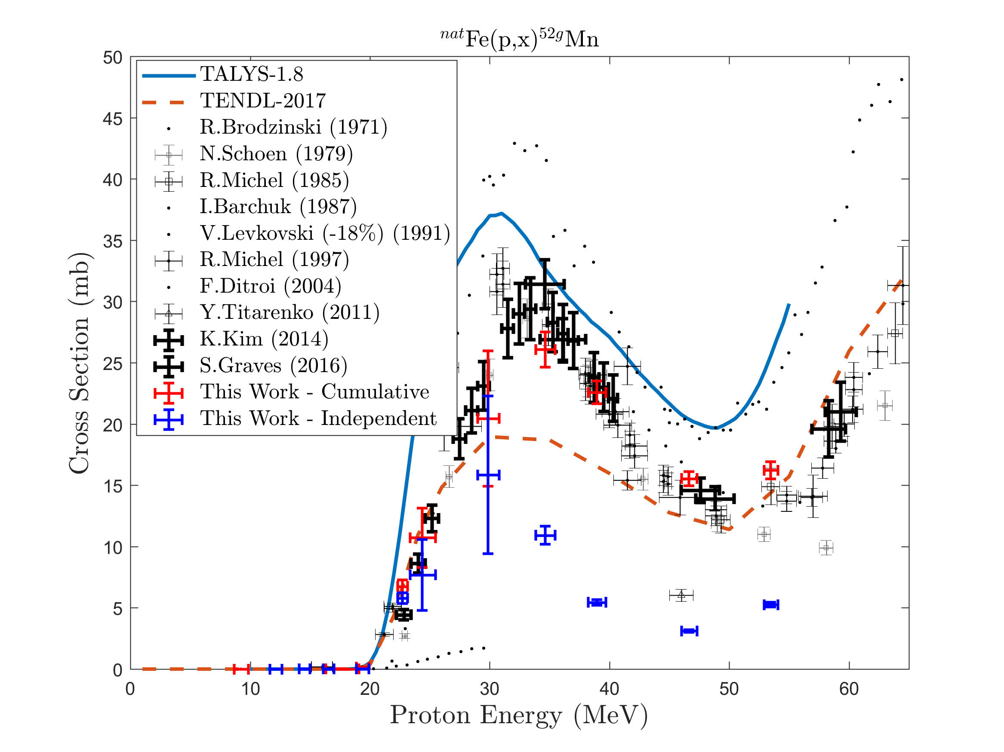
^{nat}Fe(p,x)^{51,52}Mn – Novel PET imaging
Emerging medical radionuclides
⁵¹Mn (t_{1/2} = 46 min, 97% β⁺) – short-lived PET tracer for metabolic studies
^{52g}Mn (t_{1/2} = 5.6 d, 29% β⁺) – long-lived PET tracer for neuron tracking, immune studies
Preliminary
Preliminary
Two overlapping stacks: E_{p}= 55→15 MeV, 25→0 MeV (120 nA@10 min, 100 nA@20 min)
Notes:
Mention issues with Levkovski!
Low peak is 54Fe(p,x), high peak is 56Fe(p,x)

Slide 17
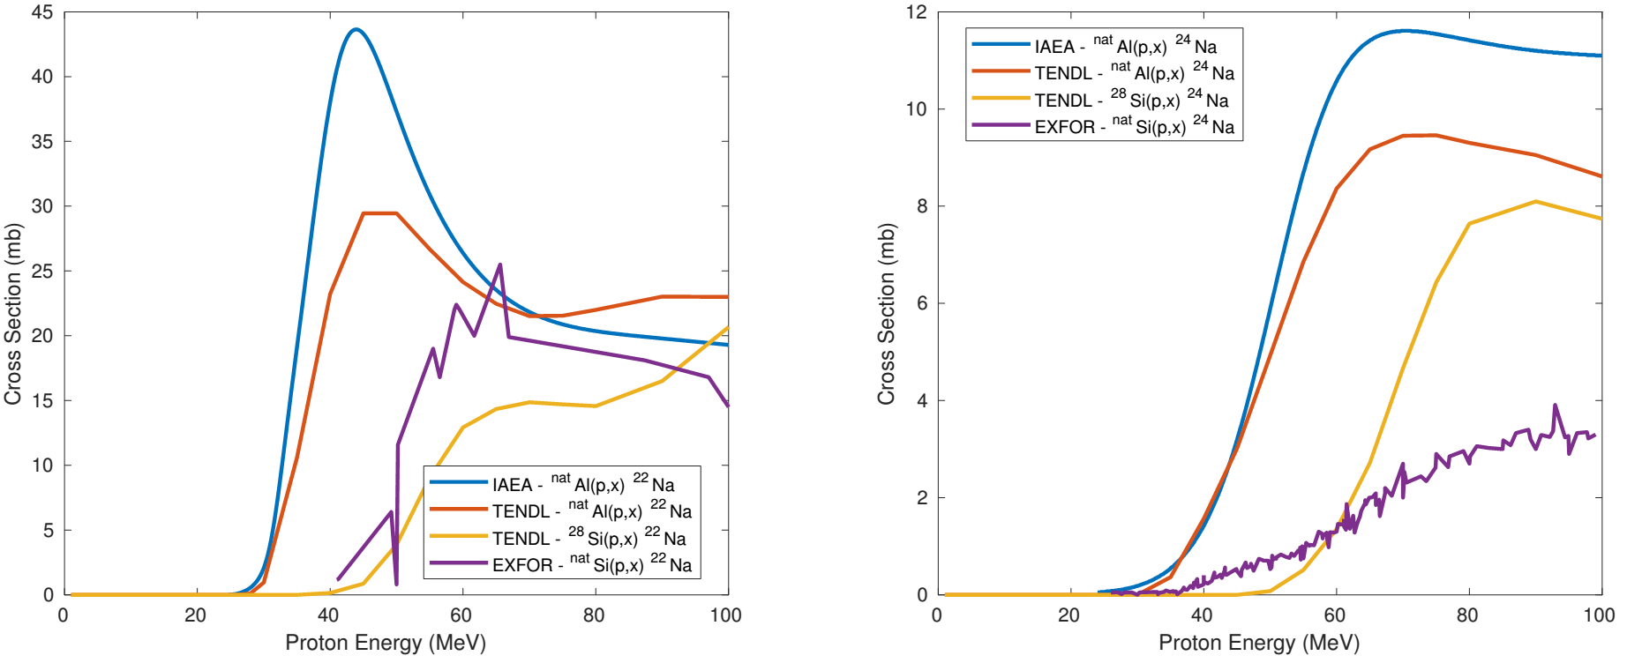

Slide 18
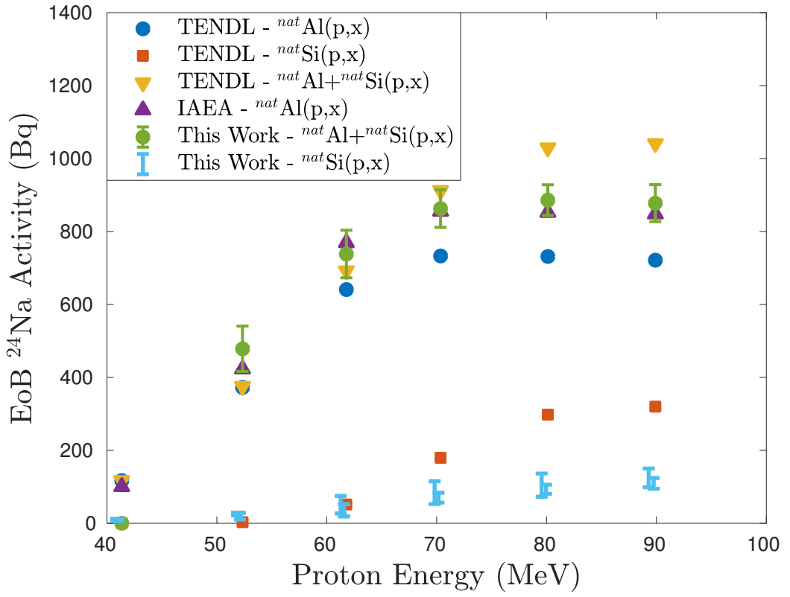
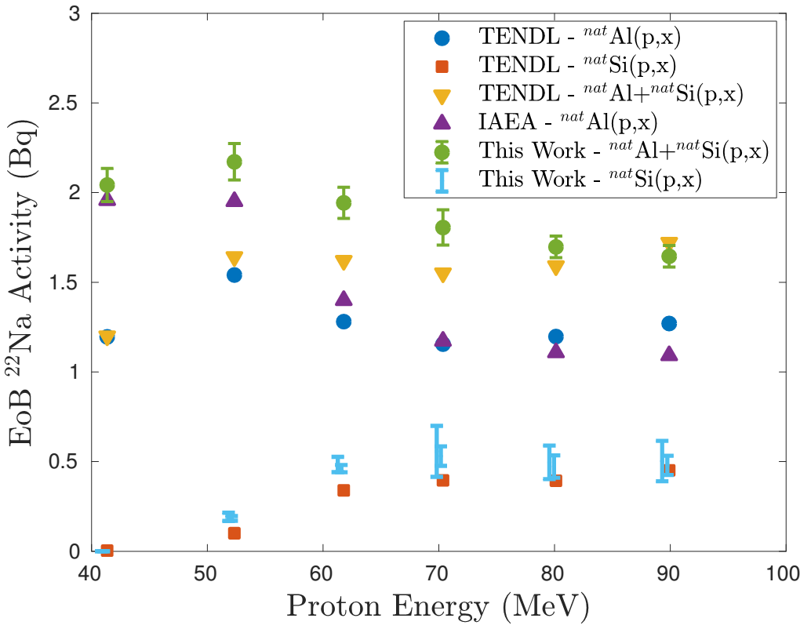

Slide 19
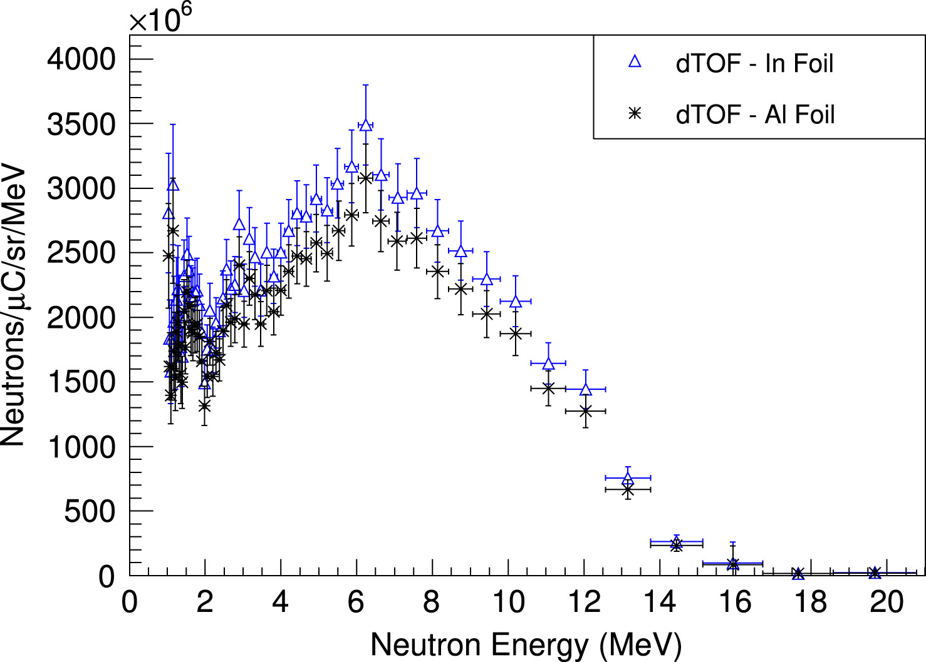
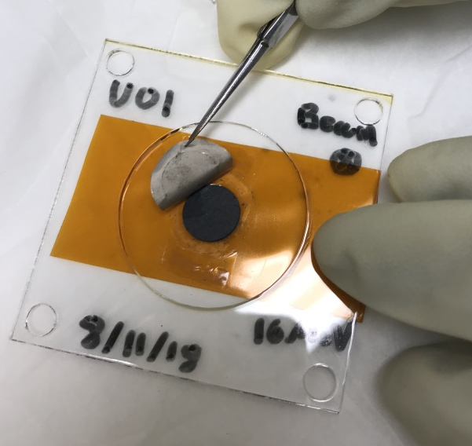
Simultaneous Radionuclide Production
≤ 50 MeV deuterons
(d,xn) target
Unreacted deuterons
Thick Be breakup target
Energetic secondary neutrons
(n,p) and/or (n,2n) target
(d,xn) reactions can produce the same radionuclide as commonly-used (p,n)
Simultaneously makes a significant energetic secondary neutron flux (ESNF) from breakup of unreacted primary deuteron beam.
ESNF can be used to produce high specific-activity radionuclides via (n,2n), or charge exchange reactions such as (n,p) and (n,α).
²³⁵U(d,n)²³⁶Np w/ Zn(n,p)^{64,67}Cu measured in August 2018!
[1] K. P. Harrig, et al., “Neutron Spectroscopy for pulsed beams with frame overlap using a double time-of-flight technique,” NIM A, 877, pp. 359–366, 2018.

Slide 20
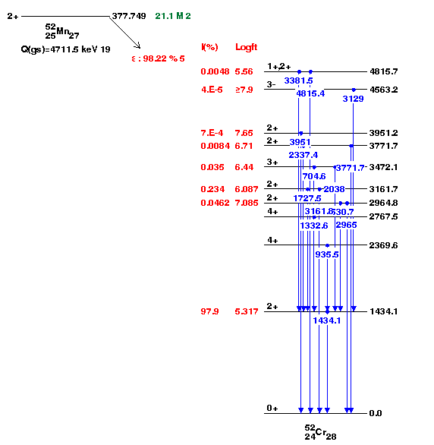
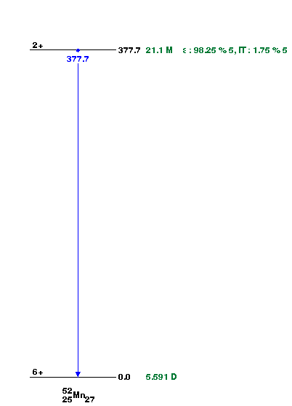
 | ^{52g}Mn | ^{52m}Mn | ⁵¹Mn
Half Life | 5.6 d | 21 m | 46 m
β⁺ Branch | 29% | 97% | 97%
β⁺ Avg. Energy | 242 keV | 1172 keV | 973 keV
Gammas | 744, 935, 1434, … | 1434 | 749

Slide 21
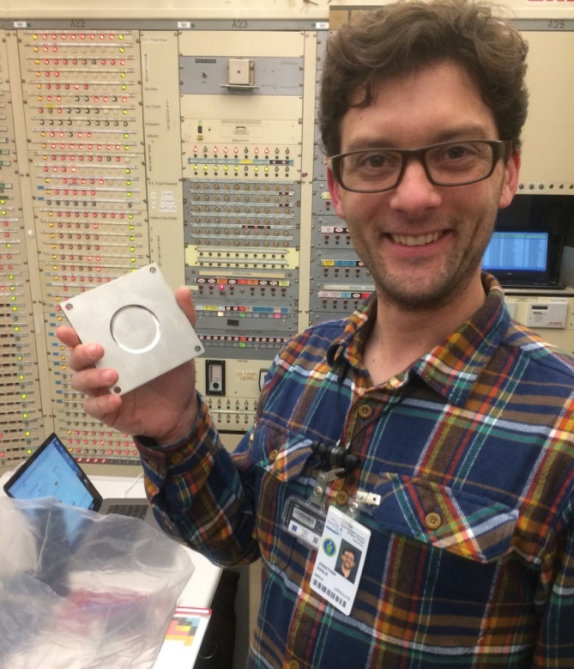
⁷Li(p,n) “Quasi-Monoenergetic” Neutron Source
Vault-based irradiation
Inconel-clad Li targets
(LANL LDRD)
Unreacted protons
0°
-20°
Li(p,n) neutron
production target
Jon Engle
Neutrons from 0-60 MeV
Y, Co, Al, In, Zr, Au samples irradiated in the vault
Unreacted beam dumped in Cave 0
Flux from 10⁶⁻⁴ /MeV/sr/s (decreases w/E_{n})
First experiments took place in April 2018
Notes:
This is the same method used at the new FRANZ facility in Frankfurt.

